Slide 1
Club Meeting
Club No. 88249
Rotary Club of Bonifacio Global City Central
01 September 2020
Virtual Meeting via MS Teams

Slide 2
Club Meeting Schedule
19:00
Call to Order
19:05
Invocation / Anthem
19:10
Welcome Remarks
19:15
Club Officers Reporting
President’s Corner
Secretary’s Notes
Treasurer’s Time
Club Admin’s Segment
19:30
Committee Chair Briefings
19:40
Speaker (19:40 – 19:50)
Guest Speaker (19:50 – 20:20)
20:20
Membership Dialogue
20:30
Adjournment

Slide 3









Invocation / National Anthem
Let us bow our heads:
Lord of the Universe, you have given most of mankind a strong desire to do good, to be honest, to serve others, and to faithfully fulfill their obligations to their neighbors.
Help us, as Rotarians and humans, to do good.
Help us, as Rotarians and humans, to be honest and ethical in all our dealings.
Help us, as Rotarians and humans, to serve others.
And help us, as Rotarians and humans, to faithfully fulfill our obligations as neighbors to our community, our nation, and the world. Amen.

Slide 4
Welcome
Guests and Visiting Rotarians
  Dr. Luis E. Abola – Guest Speaker
  Isaac Willis – Guest / Prospective Member
  Francine Geli – Rotaract Club President
  Rotaractors in attendance

Slide 5
Club Officers Reporting
President – PVP Rich
Secretary – Rtn Martyn
Treasurer – Rtn Amal
Club Admin – Rtn Janet

Slide 6
President’s Corner
Service Projects Updates
  Compassionate Hope
    reached out to Pastor Al
    21 kids / 4 in college
    P80,000/month food expenses
    water well P15k for 20ft pipe * (9-10 pipes needed) + P30k pump = ~ P200k
    seeds / vegetable garden
  Online Forum on Wellness, Leadership and Mentoring
  BGC Greenway
  Digital Learning Boards
  Vocation Seminars / Online Tutoring
Fundraising
  Online shows/exhibits – October/November timeframe (planning)
  Online auction – content to Rotaract
  Crowdsourcing – obtain member volunteers to prepare detailed write-ups of service projects; utilize justpay.to link for donations

Slide 7
President’s Corner: Vocation Seminars / Mental Health Initiatives
Vocation Seminars:
PLAN:
  Schedule with Taguig school contacts
  Donations from data providers
  Schedule online seminars with partner schools
  Facebook Live is a suggested platform for ease of access
ACTION:
  Continue to work with principals on timing and platform
  Prepare speaking parts of volunteer Rotarians
  Schedule timing (dates/times)
Mental Health Initiatives:
PLAN:
  Online Forum on Wellness, Leadership and Mentoring
  Work with Rotaract members to initiate the forum
  Start on a “coffee table chat” approach
  Discuss current environment, coping with the challenges
  Identify what is needed by our Rotaract Club and our collegiate youth
ACTION:
  Prepare profile of Club Members
  Schedule once a month mentoring call with Rotaract
  Club Committee on Youth Program
Notes:
Mental Health Initiatives:
1. This service project will be renamed as Wellness, Leadership and Mentoring Forurms
A. This will allow for more flexibility and in the types of initiatives and online delivery of the phases/modules
B. This can shift to more online/virtual service delivery to participants
2. The starting point for this service project is to solicit from our members an inventory of backgrounds and knowledge surrounding wellness, leadership and mentoring.
A. Rtn Donna will initiate a document to distribute through the membership base to identify areas of knowledge and expertise surrounding the service project so members can act as resource speakers and/or moderators in the planned forums.
B. Members will submit their profiles in the distributed documents, and can identify key themes and strengths of the members in conducting the forum.
3. A good starting point is to carry out the service projects with our newly formed Rotaract Club, that mainly comprises of collegiate age members from Enderun Colleges.
A. The service project committee for Wellness, Leadership and Mentoring will work with Rotaract to guide them in the strengthening and formation of their club.
B. Identify needs of our Rotaract club in the areas of Wellness, Leadership and Mentoring
C. Attend Rotaract Club meetings on a monthly basis to gather information from the members.
D. Plan and schedule an online forum, in the form of a “coffee table chat” with the interested members of Rotaract.
4. Once the Online Forums have been defined and refined for the needs of the Rotaract members, the service project can possibly expand to other Rotaract Clubs in the district, or other demographics in the community that would like to participate in such online forums.

Slide 8
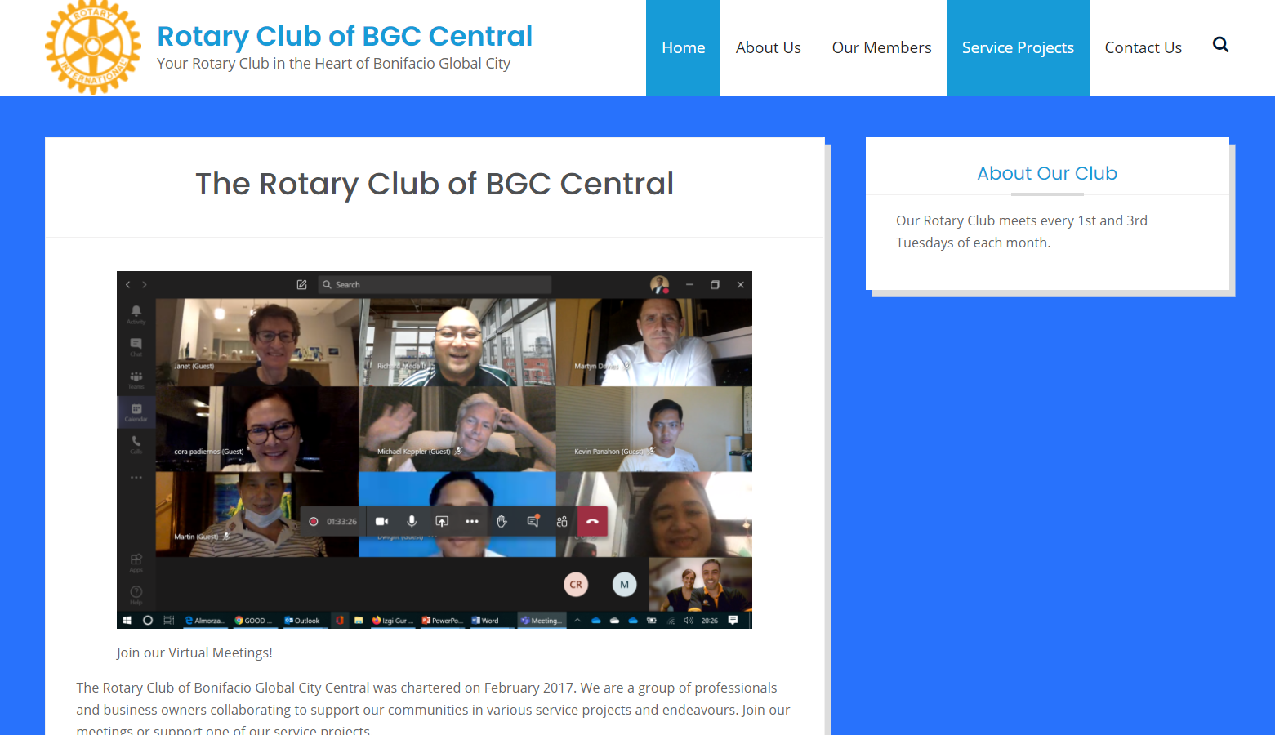
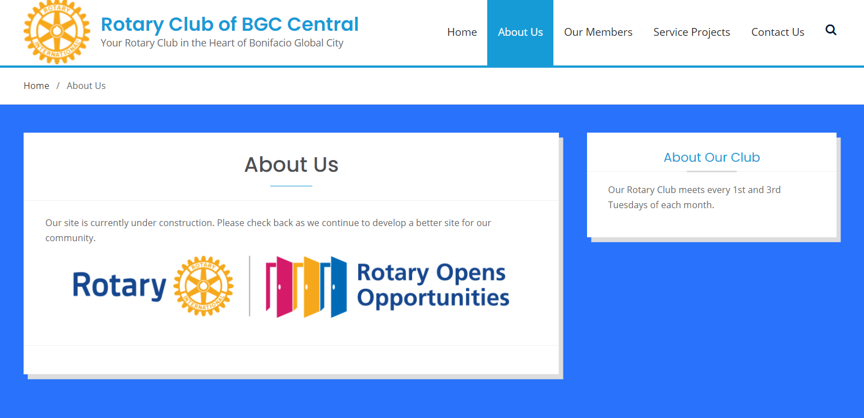
President’s Corner: rcbgccentral.online
Website:
LANDING PAGE:
  Welcome Message
  Schedule of meetings
  Scrolling online auctions
  Links to Rotary International
ABOUT US:
  Charter of the Club
  Our Story
Notes:
Mental Health Initiatives:
1. This service project will be renamed as Wellness, Leadership and Mentoring Forurms
A. This will allow for more flexibility and in the types of initiatives and online delivery of the phases/modules
B. This can shift to more online/virtual service delivery to participants
2. The starting point for this service project is to solicit from our members an inventory of backgrounds and knowledge surrounding wellness, leadership and mentoring.
A. Rtn Donna will initiate a document to distribute through the membership base to identify areas of knowledge and expertise surrounding the service project so members can act as resource speakers and/or moderators in the planned forums.
B. Members will submit their profiles in the distributed documents, and can identify key themes and strengths of the members in conducting the forum.
3. A good starting point is to carry out the service projects with our newly formed Rotaract Club, that mainly comprises of collegiate age members from Enderun Colleges.
A. The service project committee for Wellness, Leadership and Mentoring will work with Rotaract to guide them in the strengthening and formation of their club.
B. Identify needs of our Rotaract club in the areas of Wellness, Leadership and Mentoring
C. Attend Rotaract Club meetings on a monthly basis to gather information from the members.
D. Plan and schedule an online forum, in the form of a “coffee table chat” with the interested members of Rotaract.
4. Once the Online Forums have been defined and refined for the needs of the Rotaract members, the service project can possibly expand to other Rotaract Clubs in the district, or other demographics in the community that would like to participate in such online forums.

Slide 9
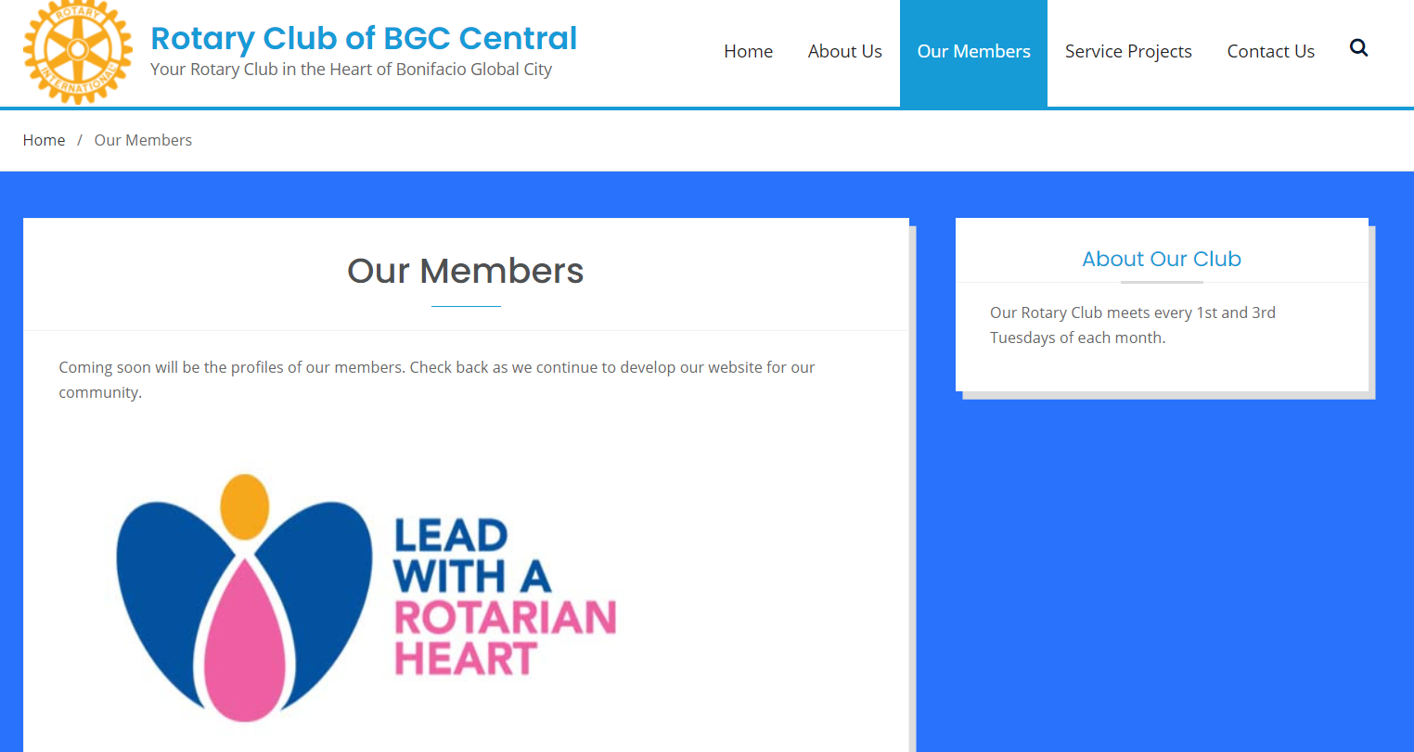
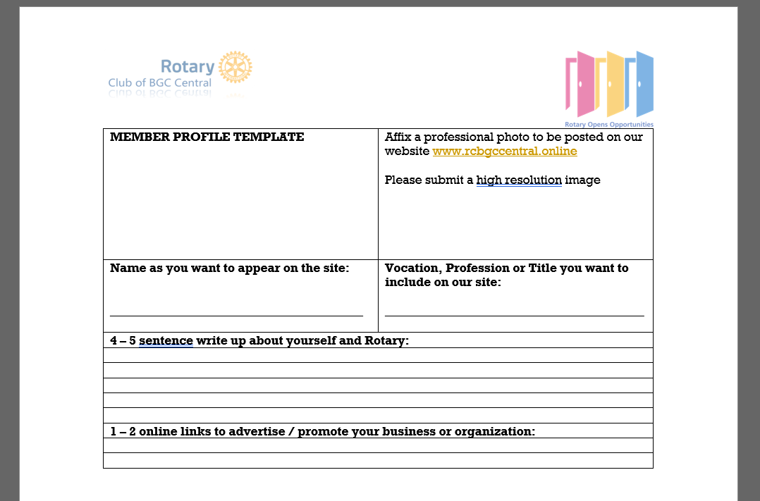
President’s Corner: rcbgccentral.online
Website:
OUR MEMBERS:
  Member Name and Photo
  Vocation/Profession/Business
  Link/Advertise your Business and Organization
  Refer to Template for Member Profiles
Notes:
Mental Health Initiatives:
1. This service project will be renamed as Wellness, Leadership and Mentoring Forurms
A. This will allow for more flexibility and in the types of initiatives and online delivery of the phases/modules
B. This can shift to more online/virtual service delivery to participants
2. The starting point for this service project is to solicit from our members an inventory of backgrounds and knowledge surrounding wellness, leadership and mentoring.
A. Rtn Donna will initiate a document to distribute through the membership base to identify areas of knowledge and expertise surrounding the service project so members can act as resource speakers and/or moderators in the planned forums.
B. Members will submit their profiles in the distributed documents, and can identify key themes and strengths of the members in conducting the forum.
3. A good starting point is to carry out the service projects with our newly formed Rotaract Club, that mainly comprises of collegiate age members from Enderun Colleges.
A. The service project committee for Wellness, Leadership and Mentoring will work with Rotaract to guide them in the strengthening and formation of their club.
B. Identify needs of our Rotaract club in the areas of Wellness, Leadership and Mentoring
C. Attend Rotaract Club meetings on a monthly basis to gather information from the members.
D. Plan and schedule an online forum, in the form of a “coffee table chat” with the interested members of Rotaract.
4. Once the Online Forums have been defined and refined for the needs of the Rotaract members, the service project can possibly expand to other Rotaract Clubs in the district, or other demographics in the community that would like to participate in such online forums.

Slide 10
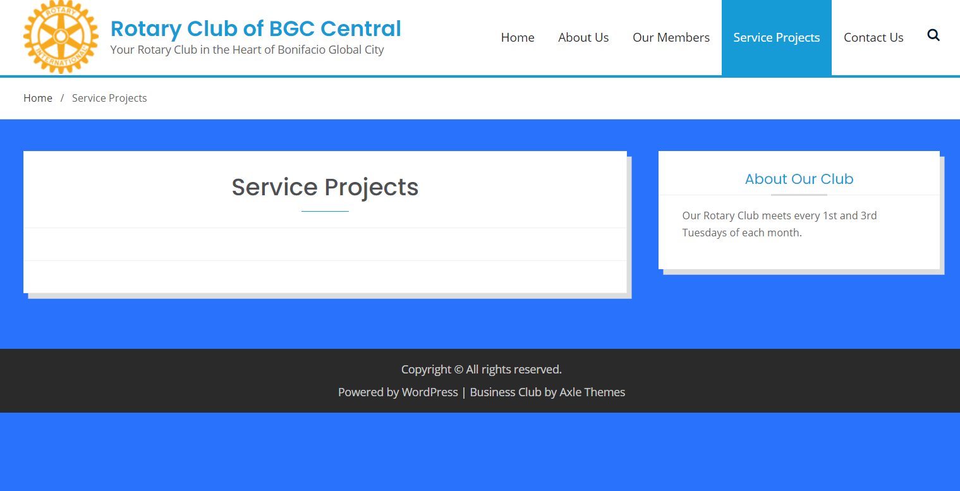
President’s Corner: rcbgccentral.online
Website:
SERVICE PROJECTS:
  Detailed write-up of our Service Projects
  Justpay.to link for sourcing contributions
  Crowdsourcing links
Notes:
Mental Health Initiatives:
1. This service project will be renamed as Wellness, Leadership and Mentoring Forurms
A. This will allow for more flexibility and in the types of initiatives and online delivery of the phases/modules
B. This can shift to more online/virtual service delivery to participants
2. The starting point for this service project is to solicit from our members an inventory of backgrounds and knowledge surrounding wellness, leadership and mentoring.
A. Rtn Donna will initiate a document to distribute through the membership base to identify areas of knowledge and expertise surrounding the service project so members can act as resource speakers and/or moderators in the planned forums.
B. Members will submit their profiles in the distributed documents, and can identify key themes and strengths of the members in conducting the forum.
3. A good starting point is to carry out the service projects with our newly formed Rotaract Club, that mainly comprises of collegiate age members from Enderun Colleges.
A. The service project committee for Wellness, Leadership and Mentoring will work with Rotaract to guide them in the strengthening and formation of their club.
B. Identify needs of our Rotaract club in the areas of Wellness, Leadership and Mentoring
C. Attend Rotaract Club meetings on a monthly basis to gather information from the members.
D. Plan and schedule an online forum, in the form of a “coffee table chat” with the interested members of Rotaract.
4. Once the Online Forums have been defined and refined for the needs of the Rotaract members, the service project can possibly expand to other Rotaract Clubs in the district, or other demographics in the community that would like to participate in such online forums.

Slide 11
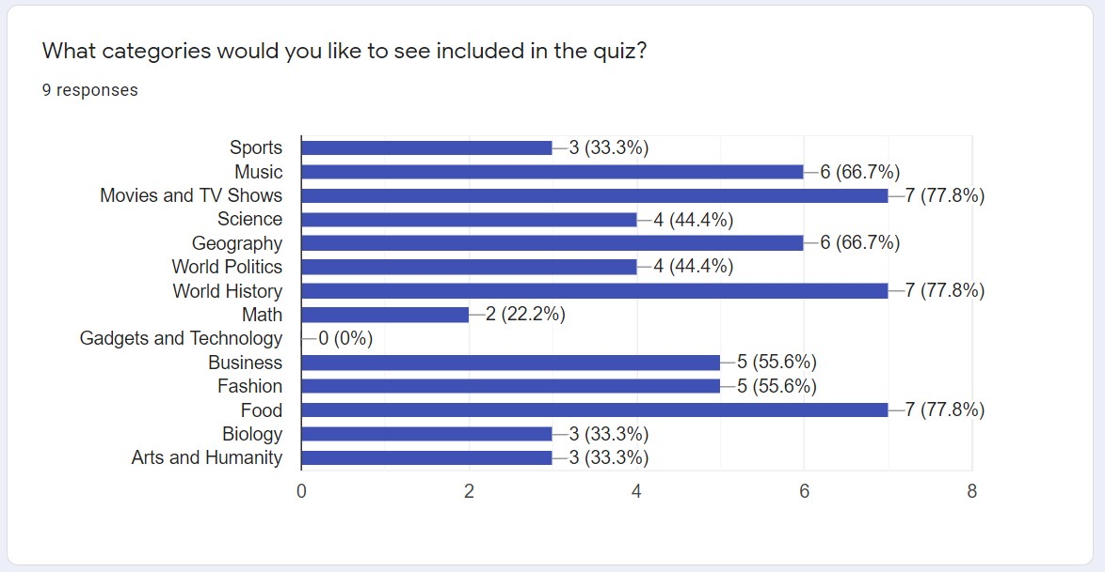
President’s Corner: Online Fellowship
Pub Quiz Night:
Saturday, Sept 5th
6:00 pm
Rotarians and Rotaractors form teams to compete against each other in a battle of wit, courage, strength and mental abilities! Show off your drinking skills too ☺
Notes:
Mental Health Initiatives:
1. This service project will be renamed as Wellness, Leadership and Mentoring Forurms
A. This will allow for more flexibility and in the types of initiatives and online delivery of the phases/modules
B. This can shift to more online/virtual service delivery to participants
2. The starting point for this service project is to solicit from our members an inventory of backgrounds and knowledge surrounding wellness, leadership and mentoring.
A. Rtn Donna will initiate a document to distribute through the membership base to identify areas of knowledge and expertise surrounding the service project so members can act as resource speakers and/or moderators in the planned forums.
B. Members will submit their profiles in the distributed documents, and can identify key themes and strengths of the members in conducting the forum.
3. A good starting point is to carry out the service projects with our newly formed Rotaract Club, that mainly comprises of collegiate age members from Enderun Colleges.
A. The service project committee for Wellness, Leadership and Mentoring will work with Rotaract to guide them in the strengthening and formation of their club.
B. Identify needs of our Rotaract club in the areas of Wellness, Leadership and Mentoring
C. Attend Rotaract Club meetings on a monthly basis to gather information from the members.
D. Plan and schedule an online forum, in the form of a “coffee table chat” with the interested members of Rotaract.
4. Once the Online Forums have been defined and refined for the needs of the Rotaract members, the service project can possibly expand to other Rotaract Clubs in the district, or other demographics in the community that would like to participate in such online forums.

Slide 12


UPDATE
Rotaract Club of Enderun Colleges President: Francine Geli
For RY 2020-2021: Open invite to join Rotary Club Meetings 1st and 3rd Tuesdays monthly
PLANS:
  Induction – re-scheduled to Sept 15th; District Committee Chair will be guest
  Monthly Meetings
  Assist with Vocation Seminar / Online Career Talks
  Website Development
    Content Development
    Online Fundraising / Auctions
    Content Management
  Leadership & Mentoring
    Work with Rich and Donna to commence Online Coffee Table Talks/Forums
  Service Projects

Slide 13
Secretary’s Notes
RY 2020-2021

Slide 14
Treasurer’s Time
RY 2020-2021
Club Dues – reminder to submit payments to the Treasurer (refer to Whatsapp roster 12/20 – 60% paid)
Payment for RI Invoice
Governor’s Fund
Philippine Rotary Magazine
Payment Link: www.justpay.to/rotaryclubbgccentral

Slide 15
Club Admin’s Segment
RY 2020-2021

Slide 16
Committee Chair Briefings
Membership – Rtn Cora
Service Projects and Public Image Co-Chairs – Rtn OO and Rtn Donna
Foundation – PP Gabe

Slide 17
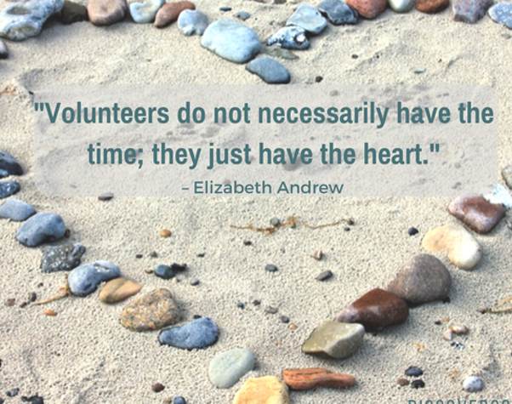
Membership Chair Briefing
Membership –
  District Membership Seminar Opening Plenary 08AUG2020 9-11am
  Breakout Session 14AUG2020 7:30-9:30pm
  Closing Session 29AUG2020 9-11am
  What did we tackle?
    Membership Organic Growth and Sustainability Discussions
    What do we want – why are we doing it?
    What do you believe in?
    How can we innovate?
    What is our visibility in our community?

Slide 18

Membership Chair Briefing: Membership Organic Growth and Sustainability Discussions
What is our visibility in our community?
What do we want?
1. We can create corporate membership.
2. Ask family members at lower membership fees.
3. We do special zoom meetings; bring a friend.
4. Our strength is our multicultural culture which the other clubs don’t have.
How can we innovate?
What do you believe in?

Slide 19

Vocation Speaker
Vocation Talk
Speaker:
Rotarian Kevin Panahon

Slide 20
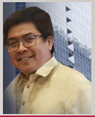
Guest Speaker: Luis E. Abola, MD, FPCP, FPSG
Talk: COVID Update
Fellow, Philippine College of Physicians
Life Fellow
  Philippine Society of Gastroenterology
  Philippine Society of Digestive Endoscopy
Member
  Hepatology Society of the Philippines
  Quezon City Medical Society
Assistant Professor, Department of Medicine, UERMMMCi
Chief, Section of Gastroenterology, UERMMMCi
Medical Director, Multicare Pharmaceuticals Philippines,Inc.
Peer Reviewer, Philippine Journal of Internal Medicine
Past Chair, Philippine Specialty Board of Gastroenterology
Past President
  Philippine Society of Digestive Endoscopy
  Philippine College of Pharmaceutical Medicine

Slide 21

Membership Dialogue
Quick updates from our members
  Life
  Business
  Family
  Activities
  Etc.

Slide 22
Adjournment / Reminders
Member Profile templates for Website and Mentoring Initiative
Pub Quiz Night Fellowship: SATURDAY Sept 5th, 6pm
Next Club Meeting: Sept 15th, 7 pm
  Rotaract Induction
  Guest Speaker on Youth Athletics
  Rotary District Guest: DCC – Youth Programs
Rotary Convention 2021: Taipei, Taiwan Registration Ongoing

