Slide 1
Club Meeting
Club No. 88249
Rotary Club of Bonifacio Global City Central
15 September 2020
Virtual Meeting via MS Teams

Slide 2
Club Meeting Schedule
19:00
Call to Order
19:05
Invocation / Anthem
19:10
Welcome Remarks
19:15
Rotaract Induction Ceremony
19:50
Guest Speaker: Ada Milby
20:10
Club Officers Reporting
20:20
Membership Dialogue
20:30
Adjournment
Speaker: DCC Archie Reano
President’s Corner
Secretary’s Notes
Treasurer’s Time
Club Admin’s Segment

Slide 3









Invocation / National Anthem
May those assembled here today enjoy the many offerings of Rotary. May we abide by the rules we have established, those of trust, fellowship and ethics, and may we place Service above Self, in our daily endeavors. And may we always test ourselves and our efforts to be sure they are the truth, good for all concerned, of benefit to mankind, and provide peace ands understanding. Amen.

Slide 4
Welcome
Guests and Visiting Rotarians
  District Committee Chair Archie Reano
  Guest Speaker Ada Milby
  Francine Geli – Rotaract Club President
  Rotaractors in attendance

Slide 5
Rotaract Induction Ceremony
Recitation of the 4-Way Test – Service Projects and Public Image Co-Chair Rtn Ofelia Orcales
Induction of Officers and Members of The Rotaract Club of Enderun Colleges
  Charging of the Officers and Directors – DCC Archie Reano
  Oath of Officers and Members – PVP Rich Medalla
  Inaugural Speech by Rotaract President – Francine Geli
Closing Remarks – PVP Rich Medalla

Slide 6
The Four Way Test

Slide 7
District Committee Chair on Youth Programs
Archimedes G. Reano
  Archimedes, his real name, was derived from a Greek mathematician, astronomer and inventor. Surprisingly, all these have traits that best describes Archie. More so, he has always been a cheerful, hardworking and an intellectual individual.
  As an entrepreneur, he has been through all phases and has worked his way up the ladder even on their own family business, Broadchem Philippines Biopharma Corporation, which he now oversees being the company’s CEO and President. As part of his work, he travels every so often to their principals and suppliers in Europe and Asia to keep up with the growing demands of the business.
  As a people-person, it is natural for him to communicate smoothly with anybody thus being in Rotary makes it rewarding and fulfilling on top of the joy that it brings in helping people improve their lives through Rotary’s sustainable projects.
  Archie as he is fondly called, is the fourth among five children of RCMN’s Past President Joe and Rotary Ann Choi Reaño. Both were his strong influences on extending social services and most of his beliefs that has molded his character up to this day.
  Archie has been married to his wife of 18 years, Kristine, who has borne him with four wonderful and active children where three are now teenagers and their youngest at six years old. All four kids carry the couple’s names which they combined to “Arstin” followed by second names from the Bible.
  He has been an active Rotarian since 2008 whom he was sponsored by his father, PP Joe. From then on, he continuously served the community as the Youth Project Chair which is really close to his heart. In 2011, he’s humbled to take the seat as the Club President of RC Makati North. In 2015-16, he performed his duties as one of Gov. Pepito Bengson’s Assistant Governors. And for 2018-19, he served as the District’s Rotaract Chair. Also, he has been a Paul Harris Society member since 2015. In RY2019-20, he served again as Club President.

Slide 8
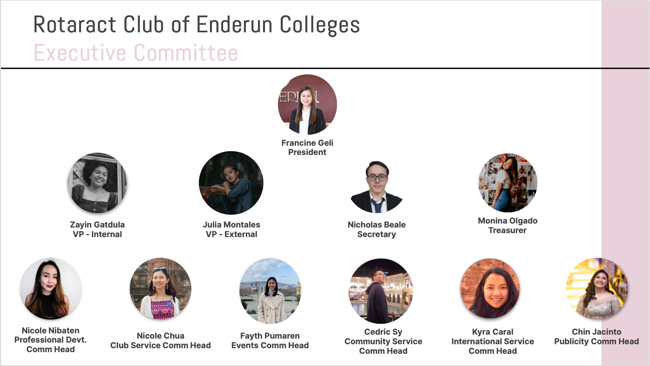

Slide 9
Induction Closing Remarks
Serving Humanity
Making a Difference
Connecting the World

Slide 10
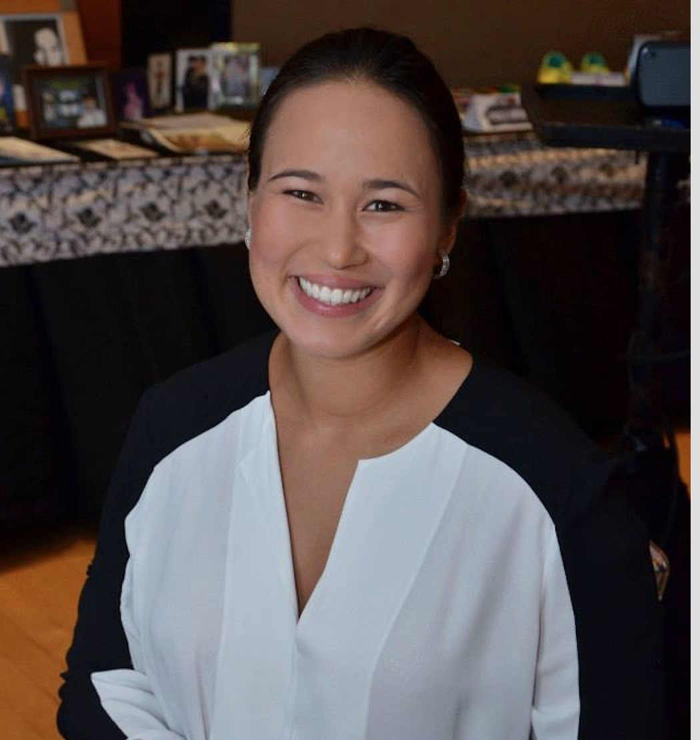
Guest Speaker: Ada Milby
Ada is a former captain for the Philippine National Women’s teams (15s and 7s). She is currently the Secretary General for Philippine Rugby Football Union and a member of Asia Rugby Executive Committee, chairing the Women's Advisory Committee that promotes the acceleration and visibility of women in rugby throughout Asia. She also serves on the Philippine National Olympic Committee Women in Sports Commission and was the first woman appointed to World Rugby Council, rugby’s highest decision-making body.

Slide 11
Club Officers Reporting
President – PVP Rich
Secretary – Rtn Martyn
Treasurer – Rtn Amal
Club Admin – Rtn Janet

Slide 12
President’s Corner
Service Projects Updates
  Compassionate Hope
    reached out to Pastor Al
    21 kids / 4 in college
    P80,000/month food expenses
    water well P15k for 20ft pipe * (9-10 pipes needed) + P30k pump = ~ P200k
    seeds / vegetable garden
  Online Forum on Wellness, Leadership and Mentoring
  BGC Greenway
  Digital Learning Boards
  Vocation Seminars / Online Tutoring
Fundraising
  Online shows/exhibits – October/November timeframe (planning)
  Online auction – content to Rotaract
  Crowdsourcing – obtain member volunteers to prepare detailed write-ups of service projects; utilize justpay.to link for donations
  Online Marketplace for communities in need

Slide 13
President’s Corner: Vocation Seminars / Mental Health Initiatives
Vocation Seminars:
PLAN:
  Schedule with Taguig school contacts
  Donations from data providers
  Schedule online seminars with partner schools
  Facebook Live is a suggested platform for ease of access
ACTION:
  Continue to work with principals on timing and platform
  Prepare speaking parts of volunteer Rotarians
  Schedule timing (dates/times)
Mental Health Initiatives:
PLAN:
  Online Forum on Wellness, Leadership and Mentoring
  Work with Rotaract members to initiate the forum
  Start on a “coffee table chat” approach
  Discuss current environment, coping with the challenges
  Identify what is needed by our Rotaract Club and our collegiate youth
ACTION:
  Prepare profile of Club Members
  Schedule once a month mentoring call with Rotaract
  Club Committee on Youth Program
Notes:
Mental Health Initiatives:
1. This service project will be renamed as Wellness, Leadership and Mentoring Forurms
A. This will allow for more flexibility and in the types of initiatives and online delivery of the phases/modules
B. This can shift to more online/virtual service delivery to participants
2. The starting point for this service project is to solicit from our members an inventory of backgrounds and knowledge surrounding wellness, leadership and mentoring.
A. Rtn Donna will initiate a document to distribute through the membership base to identify areas of knowledge and expertise surrounding the service project so members can act as resource speakers and/or moderators in the planned forums.
B. Members will submit their profiles in the distributed documents, and can identify key themes and strengths of the members in conducting the forum.
3. A good starting point is to carry out the service projects with our newly formed Rotaract Club, that mainly comprises of collegiate age members from Enderun Colleges.
A. The service project committee for Wellness, Leadership and Mentoring will work with Rotaract to guide them in the strengthening and formation of their club.
B. Identify needs of our Rotaract club in the areas of Wellness, Leadership and Mentoring
C. Attend Rotaract Club meetings on a monthly basis to gather information from the members.
D. Plan and schedule an online forum, in the form of a “coffee table chat” with the interested members of Rotaract.
4. Once the Online Forums have been defined and refined for the needs of the Rotaract members, the service project can possibly expand to other Rotaract Clubs in the district, or other demographics in the community that would like to participate in such online forums.

Slide 14
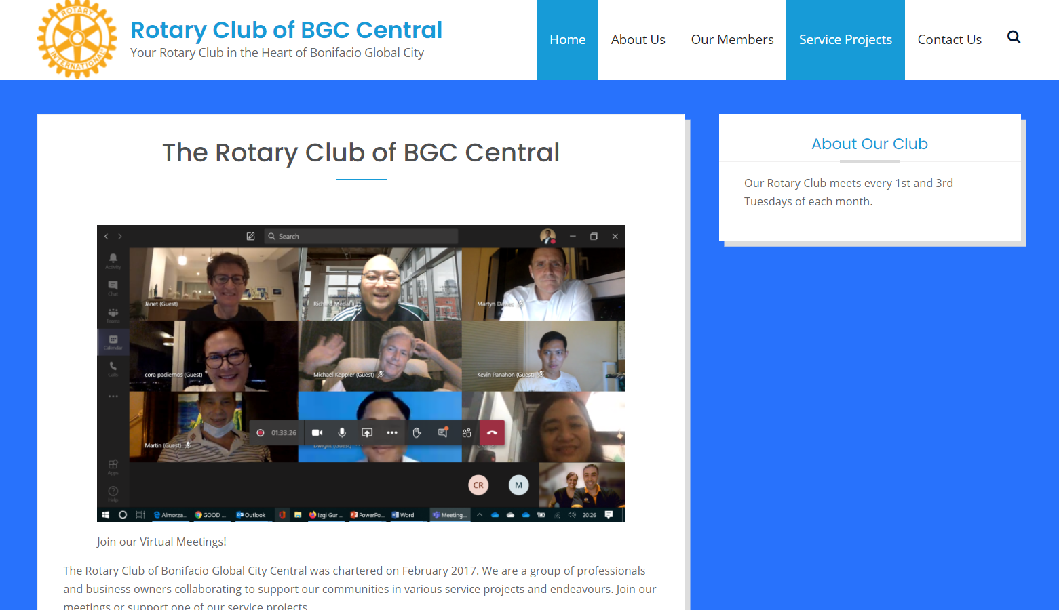
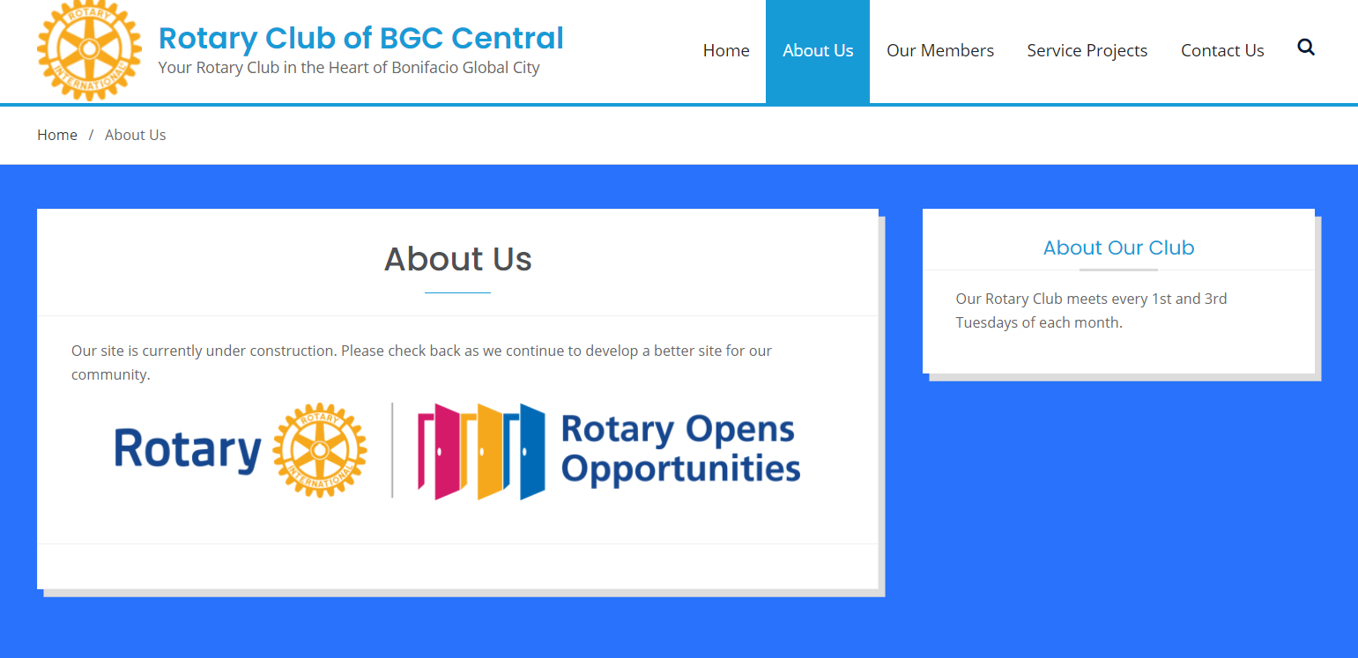
President’s Corner: rcbgccentral.online
Website:
LANDING PAGE:
  Welcome Message
  Schedule of meetings
  Scrolling online auctions
  Links to Rotary International
ABOUT US:
  Charter of the Club
  Our Story
Notes:
Mental Health Initiatives:
1. This service project will be renamed as Wellness, Leadership and Mentoring Forurms
A. This will allow for more flexibility and in the types of initiatives and online delivery of the phases/modules
B. This can shift to more online/virtual service delivery to participants
2. The starting point for this service project is to solicit from our members an inventory of backgrounds and knowledge surrounding wellness, leadership and mentoring.
A. Rtn Donna will initiate a document to distribute through the membership base to identify areas of knowledge and expertise surrounding the service project so members can act as resource speakers and/or moderators in the planned forums.
B. Members will submit their profiles in the distributed documents, and can identify key themes and strengths of the members in conducting the forum.
3. A good starting point is to carry out the service projects with our newly formed Rotaract Club, that mainly comprises of collegiate age members from Enderun Colleges.
A. The service project committee for Wellness, Leadership and Mentoring will work with Rotaract to guide them in the strengthening and formation of their club.
B. Identify needs of our Rotaract club in the areas of Wellness, Leadership and Mentoring
C. Attend Rotaract Club meetings on a monthly basis to gather information from the members.
D. Plan and schedule an online forum, in the form of a “coffee table chat” with the interested members of Rotaract.
4. Once the Online Forums have been defined and refined for the needs of the Rotaract members, the service project can possibly expand to other Rotaract Clubs in the district, or other demographics in the community that would like to participate in such online forums.

Slide 15
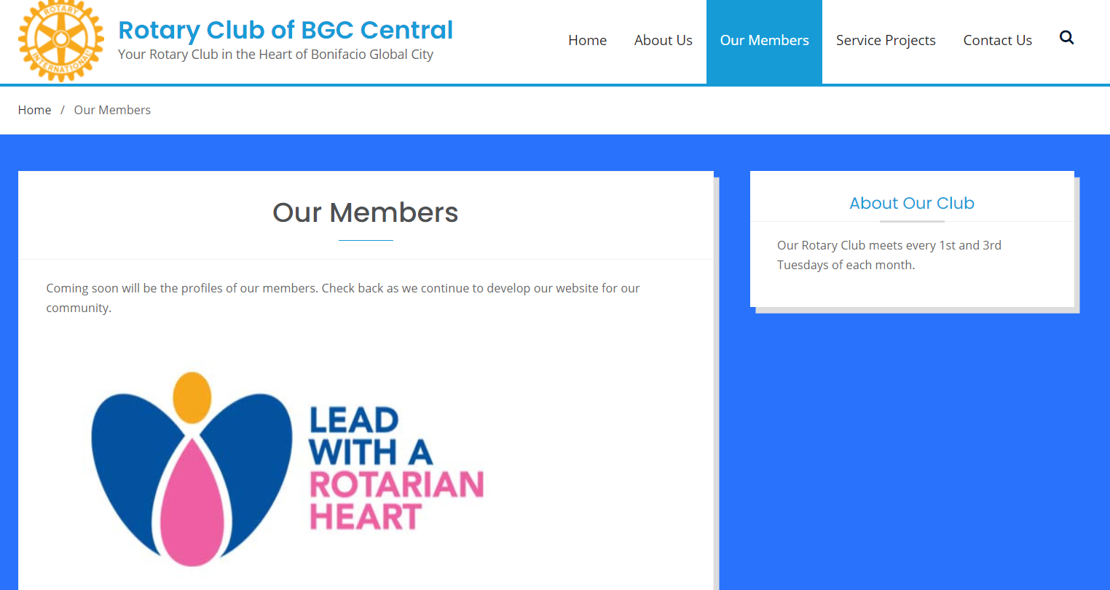
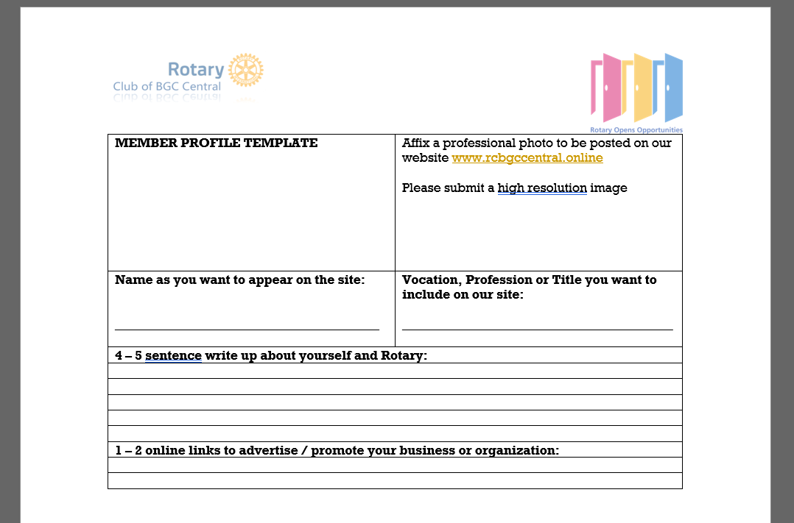
President’s Corner: rcbgccentral.online
Website:
OUR MEMBERS:
  Member Name and Photo
  Vocation/Profession/Business
  Link/Advertise your Business and Organization
  Refer to Template for Member Profiles
Notes:
Mental Health Initiatives:
1. This service project will be renamed as Wellness, Leadership and Mentoring Forurms
A. This will allow for more flexibility and in the types of initiatives and online delivery of the phases/modules
B. This can shift to more online/virtual service delivery to participants
2. The starting point for this service project is to solicit from our members an inventory of backgrounds and knowledge surrounding wellness, leadership and mentoring.
A. Rtn Donna will initiate a document to distribute through the membership base to identify areas of knowledge and expertise surrounding the service project so members can act as resource speakers and/or moderators in the planned forums.
B. Members will submit their profiles in the distributed documents, and can identify key themes and strengths of the members in conducting the forum.
3. A good starting point is to carry out the service projects with our newly formed Rotaract Club, that mainly comprises of collegiate age members from Enderun Colleges.
A. The service project committee for Wellness, Leadership and Mentoring will work with Rotaract to guide them in the strengthening and formation of their club.
B. Identify needs of our Rotaract club in the areas of Wellness, Leadership and Mentoring
C. Attend Rotaract Club meetings on a monthly basis to gather information from the members.
D. Plan and schedule an online forum, in the form of a “coffee table chat” with the interested members of Rotaract.
4. Once the Online Forums have been defined and refined for the needs of the Rotaract members, the service project can possibly expand to other Rotaract Clubs in the district, or other demographics in the community that would like to participate in such online forums.

Slide 16
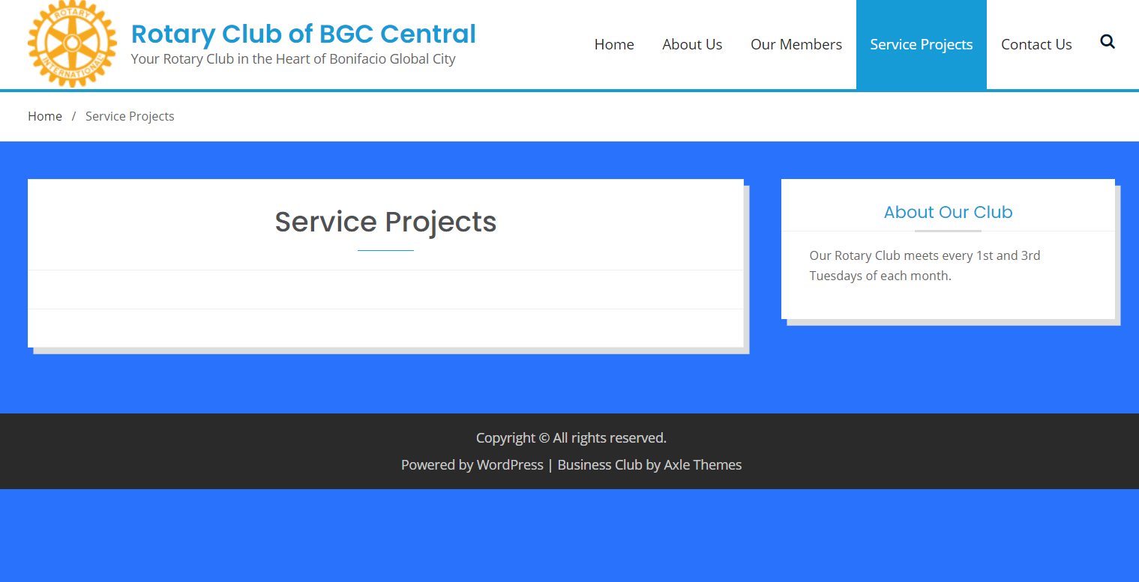
President’s Corner: rcbgccentral.online
Website:
SERVICE PROJECTS:
  Detailed write-up of our Service Projects
  Justpay.to link for sourcing contributions
  Crowdsourcing links
  Online Marketplace
Notes:
Mental Health Initiatives:
1. This service project will be renamed as Wellness, Leadership and Mentoring Forurms
A. This will allow for more flexibility and in the types of initiatives and online delivery of the phases/modules
B. This can shift to more online/virtual service delivery to participants
2. The starting point for this service project is to solicit from our members an inventory of backgrounds and knowledge surrounding wellness, leadership and mentoring.
A. Rtn Donna will initiate a document to distribute through the membership base to identify areas of knowledge and expertise surrounding the service project so members can act as resource speakers and/or moderators in the planned forums.
B. Members will submit their profiles in the distributed documents, and can identify key themes and strengths of the members in conducting the forum.
3. A good starting point is to carry out the service projects with our newly formed Rotaract Club, that mainly comprises of collegiate age members from Enderun Colleges.
A. The service project committee for Wellness, Leadership and Mentoring will work with Rotaract to guide them in the strengthening and formation of their club.
B. Identify needs of our Rotaract club in the areas of Wellness, Leadership and Mentoring
C. Attend Rotaract Club meetings on a monthly basis to gather information from the members.
D. Plan and schedule an online forum, in the form of a “coffee table chat” with the interested members of Rotaract.
4. Once the Online Forums have been defined and refined for the needs of the Rotaract members, the service project can possibly expand to other Rotaract Clubs in the district, or other demographics in the community that would like to participate in such online forums.

Slide 17


UPDATE
Rotaract Club of Enderun Colleges President: Francine Geli
For RY 2020-2021: Open invite to join Rotary Club Meetings 1st and 3rd Tuesdays monthly
PLANS:
  Monthly Meetings
  Assist with Vocation Seminar / Online Career Talks
  Website Development
    Content Development
    Online Fundraising / Auctions
    Content Management
  Leadership & Mentoring
    Scheduled for 17 SEP 2020 THURS
  Service Projects

Slide 18

Membership Dialogue
Quick updates from our members
  Life or
  Business or
  Family or
  Activities
  Etc.

Slide 19
Adjournment / Reminders
Member Profile templates for Website and Mentoring Initiative
Next Club Meeting: Oct 6th, 7 pm
  Service Projects
  Guest Speaker
  Classification Talk
Rotary Convention 2021: Taipei, Taiwan Registration Ongoing

