Slide 1
Club Meeting
Club No. 88249
Rotary Club of Bonifacio Global City Central
18 August 2020
Virtual Meeting via MS Teams

Slide 2
Club Meeting Schedule
19:00
Call to Order
19:05
Invocation / Anthem
19:10
Welcome Remarks
19:15
Club Officers Reporting
President’s Corner
Secretary’s Notes
Treasurer’s Time
Club Admin’s Segment
19:25
Committee Chair Briefings
19:35
Speakers / Guest Speakers
20:00
Membership Dialogue
20:15
Adjournment

Slide 3








Invocation / National Anthem
Let us pray silently together, each one of us, according to our individual beliefs.
Let us offer thanks for our food, blessings for one another.
Let us be a source of hope for those in need,
and contentment for those who are lonely.
Let us give gratitude for our opportunity to serve Rotary.
Let the feelings of love, kindness, and a well directed, yet gentle spirit always be reflected in our actions.
We also pray for our departed friends. May they rest in peace.
(30 seconds of silence) Amen.

Slide 4
Welcome
Guests, New Members and Visiting Rotarians
  SAG Mischa Ruiz – RC Taguig West
  PVP Fernan Mabanta - RC Makati Poblacion
  PVP Gregory “GJ” Dy - RC Makati San Lorenzo
  Salvatore & Paola LaValle – New Members
  Isaac Willis – Guest
  Francine Geli – Rotaract Club President
  Rotaractors in attendance

Slide 5
Club Officers Reporting
President – PVP Rich
Secretary – Rtn Martyn
Treasurer – Rtn Amal
Club Admin – Rtn Janet

Slide 6
President’s Corner
Service Projects Updates
  Compassionate Hope
  Sexual Abuse and Mental Health Initiatives
  BGC Greenway
  Digital Learning Boards
  Vocation Seminars
  Online Tutoring
Fundraising
  Online shows/exhibits
  Online auction
  Crowdsourcing

Slide 7
President’s Corner: Vocation Seminars / Mental Health Initiatives
Vocation Seminars:
Working with the Taguig school contacts
Working with data providers
Mental Health Initiatives:
Online Forum on Wellness, Leadership and Mentoring
Work with Rotaract members to initiate the forum
Start on a “coffee table chat” approach
Discuss current environment, coping with the challenges
Identify what is needed by our Rotaract Club and our collegiate youth
Notes:
Mental Health Initiatives:
1. This service project will be renamed as Wellness, Leadership and Mentoring Forurms
A. This will allow for more flexibility and in the types of initiatives and online delivery of the phases/modules
B. This can shift to more online/virtual service delivery to participants
2. The starting point for this service project is to solicit from our members an inventory of backgrounds and knowledge surrounding wellness, leadership and mentoring.
A. Rtn Donna will initiate a document to distribute through the membership base to identify areas of knowledge and expertise surrounding the service project so members can act as resource speakers and/or moderators in the planned forums.
B. Members will submit their profiles in the distributed documents, and can identify key themes and strengths of the members in conducting the forum.
3. A good starting point is to carry out the service projects with our newly formed Rotaract Club, that mainly comprises of collegiate age members from Enderun Colleges.
A. The service project committee for Wellness, Leadership and Mentoring will work with Rotaract to guide them in the strengthening and formation of their club.
B. Identify needs of our Rotaract club in the areas of Wellness, Leadership and Mentoring
C. Attend Rotaract Club meetings on a monthly basis to gather information from the members.
D. Plan and schedule an online forum, in the form of a “coffee table chat” with the interested members of Rotaract.
4. Once the Online Forums have been defined and refined for the needs of the Rotaract members, the service project can possibly expand to other Rotaract Clubs in the district, or other demographics in the community that would like to participate in such online forums.

Slide 8


UPDATE
Rotaract Club of Enderun Colleges President: Francine Geli
First Club Meeting: 31 Jul 2020
Club Officers
Projects:
  Vocation Seminars / Online Career Talks
  Website Development
  Online Fundraising
  E-Learning
Plans:
  Induction – Sept 1 Meeting
  Meeting Schedule
  Leadership & Mentoring
  Service Projects

Slide 9
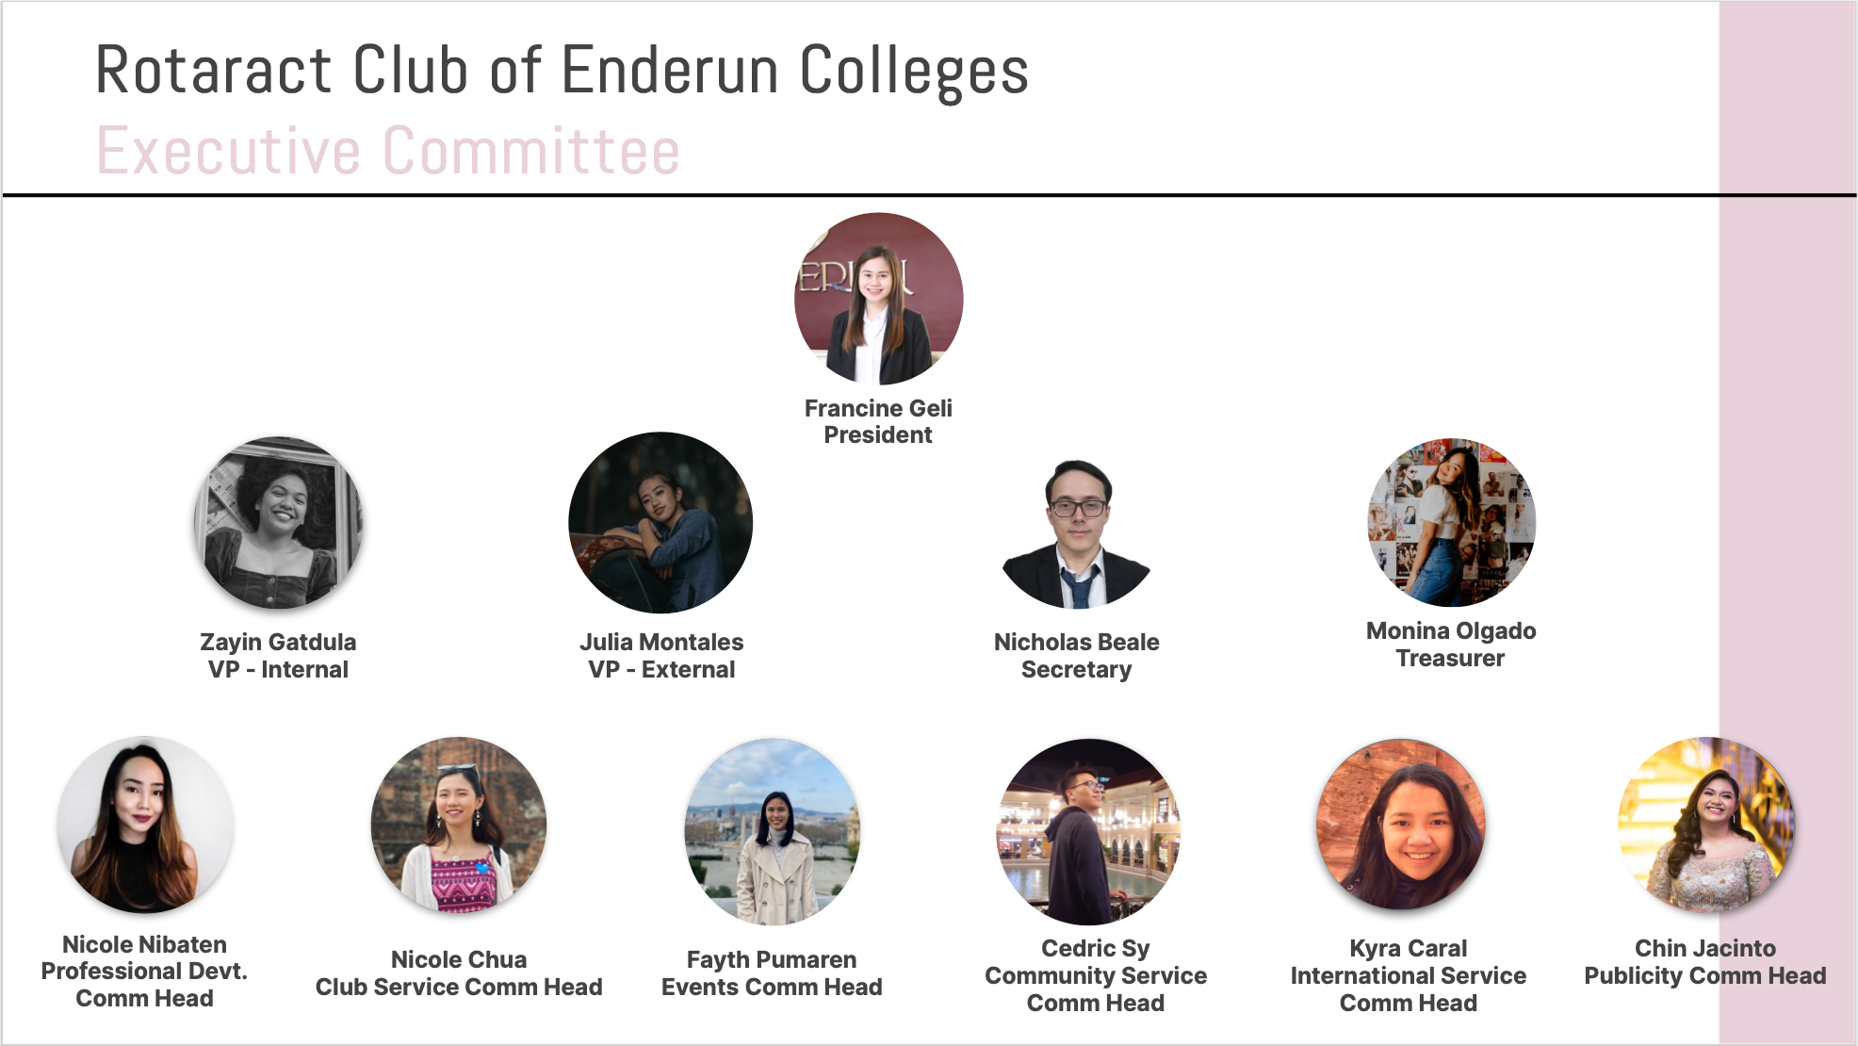

Slide 10
Treasurer’s Time
RY 2020-2021
Club Dues – reminder to submit payments to the Treasurer
Payment for RI Invoice
Governor’s Fund
Philippine Rotary Magazine
Payment Link: www.justpay.to/rotaryclubbgccentral

Slide 11
Committee Chair Briefings
Membership – Rtn Cora
Service Projects and Public Image Co-Chairs – Rtn OO and Rtn Donna
Foundation – PP Gabe

Slide 12

Membership Chair Briefing
Membership –
  District Membership Seminar Opening Plenary 08AUG2020 9-11am and Breakout Session 14AUG2020 7:30-9:30pm
  Coming soon on September 1st Club Meeting
    Membership Organic Growth and Sustainability Discussions
    What do we want – why are we doing it?
    What do you believe in?
    How can we innovate?
    What is our visibility in our community?

Slide 13

Speaker / Guest Speaker
Talk: Latest PH Tax Updates
Speaker:
Rotarian Liez “Liz” Rafal-Roble
Liz has more than ten years experience in providing tax services related to Philippine Taxes. She is a lawyer, CPA and partner with the accounting firm of SGV & Co in the tax services group. She handles clients in various industries with special tax regimes and or incentives like those who are registered with the Philippine Economic Zone Authority, Subic Bay Metropolitan Authority, Clark Development Corporation and other economic zones and the Board of Investments, regional operating headquarters, energy and utility, mining, manufacturing, electronics, telecommunications, international airlines, and those engaged in other service oriented industries like business process outsourcing, logistics, trading and consumer oriented industries. Please welcome our very own Rotarian Liz.

Slide 14

Membership Dialogue
Quick updates from our members
  Life
  Business
  Family
  Activities
  Etc.

Slide 15
Adjournment / Reminders
D3830 Membership Discovery Sessions: Aug 29, 9 am
Next Club Meeting: Sept 1st, 7 pm
  Rotaract Induction
  Guest Speaker on COVID projections
  Membership Chair Topics
Rotary Convention 2021: Taipei, Taiwan Registration Ongoing

