Slide 1
Club Meeting
Club No. 88249
Rotary Club of Bonifacio Global City Central
06 October 2020
Virtual Meeting via MS Teams

Slide 2
Club Meeting Schedule
19:00
Call to Order
19:05
Invocation / Anthem
19:10
Welcome Remarks
19:15
Club Officers Reporting
19:35
Guest Speaker: Ruby Jacob
Q & A
20:15
Membership Dialogue
20:25
Announcements
Reminders
Updates
20:30
Adjournment
President’s Corner
Secretary’s Notes
Treasurer’s Time
Club Admin’s Segment

Slide 3









Invocation / National Anthem
As each of us give our own thanks according to our personal persuasions let us dwell on some thoughts that bind us together:
"You've blessed us with friends and laughter and fun
With rain that's as soft as the light from the sun ---
You've blessed us with stars to brighten each night
You've given us help to know wrong from right --
You've given us so much please, Lord give us too,
A heart that is always Grateful to you."
Amen.

Slide 4
Welcome
Guests and Visiting Rotarians
  Guest Speaker Ruby Jacob
  Francine Geli – Rotaract Club President
  Rotaractors in attendance
  Visitors
  Gov Chacha Camacho

Slide 5
Club Officers Reporting
President – PVP Rich
Secretary – Rtn Martyn
Treasurer – Rtn Amal
Club Admin – Rtn Janet

Slide 6
President’s Corner
Service Projects Updates
  Compassionate Hope
    reached out to Pastor Al
    21 kids / 4 in college
    P80,000/month food expenses
    water well P15k for 20ft pipe * (9-10 pipes needed) + P30k pump = ~ P200k
    seeds / vegetable garden
  Mentoring & Leadership Academy
  BGC Greenway
  Digital Learning Boards
  Vocation Seminars / Online Tutoring
Fundraising
  Online auction – content to Rotaract
  Crowdsourcing – obtain member volunteers to prepare detailed write-ups of service projects; utilize justpay.to link for donations
  Online Marketplace for communities in need (Tienda Della Strada and Buy Pinoy)

Slide 7
President’s Corner: Vocation Seminars / MLA
Vocation Seminars:
PLAN:
  Schedule with Taguig school contacts
  Donations from data providers
  Schedule online seminars with partner schools
  Facebook Live as platform for ease of access
  After School Start of Oct 5th
ACTION:
  Reach out to Smart Communications
    Head of Community Relationships (Darwin Flores)
    Head of Public Affairs (Jose Rosete)
Mentoring & Leadership Academy:
PLAN:
  Online Forum on Wellness, Leadership and Mentoring
  Wellness Initiatives
  Guest Speaker Series
ACTION:
  Prepare profile of Club Members
  Schedule once a month mentoring call with Rotaract
  Club Committee on Youth Program
Notes:
Mental Health Initiatives:
1. This service project will be renamed as Wellness, Leadership and Mentoring Forurms
A. This will allow for more flexibility and in the types of initiatives and online delivery of the phases/modules
B. This can shift to more online/virtual service delivery to participants
2. The starting point for this service project is to solicit from our members an inventory of backgrounds and knowledge surrounding wellness, leadership and mentoring.
A. Rtn Donna will initiate a document to distribute through the membership base to identify areas of knowledge and expertise surrounding the service project so members can act as resource speakers and/or moderators in the planned forums.
B. Members will submit their profiles in the distributed documents, and can identify key themes and strengths of the members in conducting the forum.
3. A good starting point is to carry out the service projects with our newly formed Rotaract Club, that mainly comprises of collegiate age members from Enderun Colleges.
A. The service project committee for Wellness, Leadership and Mentoring will work with Rotaract to guide them in the strengthening and formation of their club.
B. Identify needs of our Rotaract club in the areas of Wellness, Leadership and Mentoring
C. Attend Rotaract Club meetings on a monthly basis to gather information from the members.
D. Plan and schedule an online forum, in the form of a “coffee table chat” with the interested members of Rotaract.
4. Once the Online Forums have been defined and refined for the needs of the Rotaract members, the service project can possibly expand to other Rotaract Clubs in the district, or other demographics in the community that would like to participate in such online forums.

Slide 8
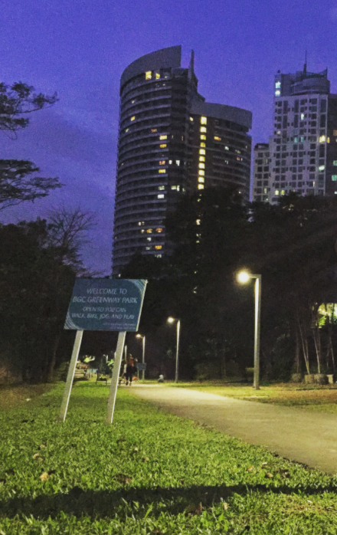
President’s Corner: BGC Greenway
UPDATES:
  Things are moving ahead on schedule and on budget.
  Awaiting approval to start the 26th Street Park.
  The project will be completed by the 2nd or 3rd week in October (less Kasalikasan that FBDC said they will upgrade in 2021).
  Will have photos once the work is complete so we can put on the website.
  In good shape budget-wise. Awaiting on Aboitiz funds for corporate sponsorship: receive their remaining Php3M contribution in Q4 2021.
Notes:
Mental Health Initiatives:
1. This service project will be renamed as Wellness, Leadership and Mentoring Forurms
A. This will allow for more flexibility and in the types of initiatives and online delivery of the phases/modules
B. This can shift to more online/virtual service delivery to participants
2. The starting point for this service project is to solicit from our members an inventory of backgrounds and knowledge surrounding wellness, leadership and mentoring.
A. Rtn Donna will initiate a document to distribute through the membership base to identify areas of knowledge and expertise surrounding the service project so members can act as resource speakers and/or moderators in the planned forums.
B. Members will submit their profiles in the distributed documents, and can identify key themes and strengths of the members in conducting the forum.
3. A good starting point is to carry out the service projects with our newly formed Rotaract Club, that mainly comprises of collegiate age members from Enderun Colleges.
A. The service project committee for Wellness, Leadership and Mentoring will work with Rotaract to guide them in the strengthening and formation of their club.
B. Identify needs of our Rotaract club in the areas of Wellness, Leadership and Mentoring
C. Attend Rotaract Club meetings on a monthly basis to gather information from the members.
D. Plan and schedule an online forum, in the form of a “coffee table chat” with the interested members of Rotaract.
4. Once the Online Forums have been defined and refined for the needs of the Rotaract members, the service project can possibly expand to other Rotaract Clubs in the district, or other demographics in the community that would like to participate in such online forums.

Slide 9
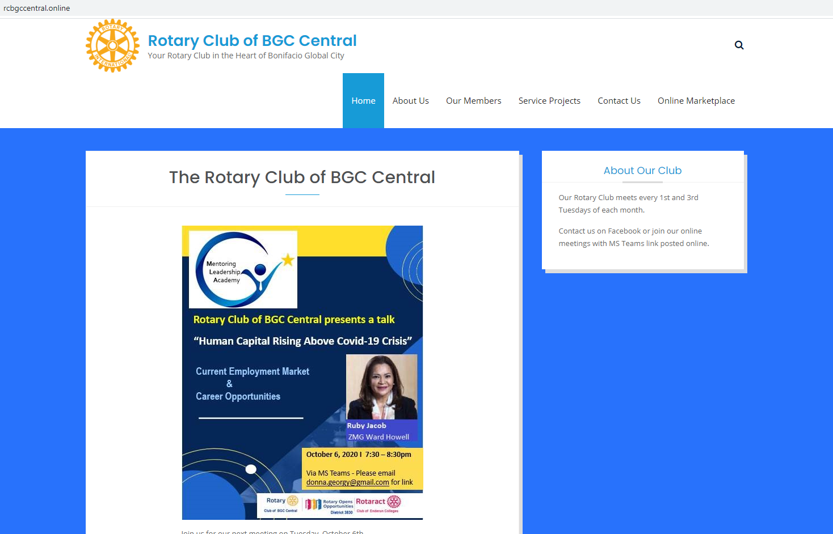
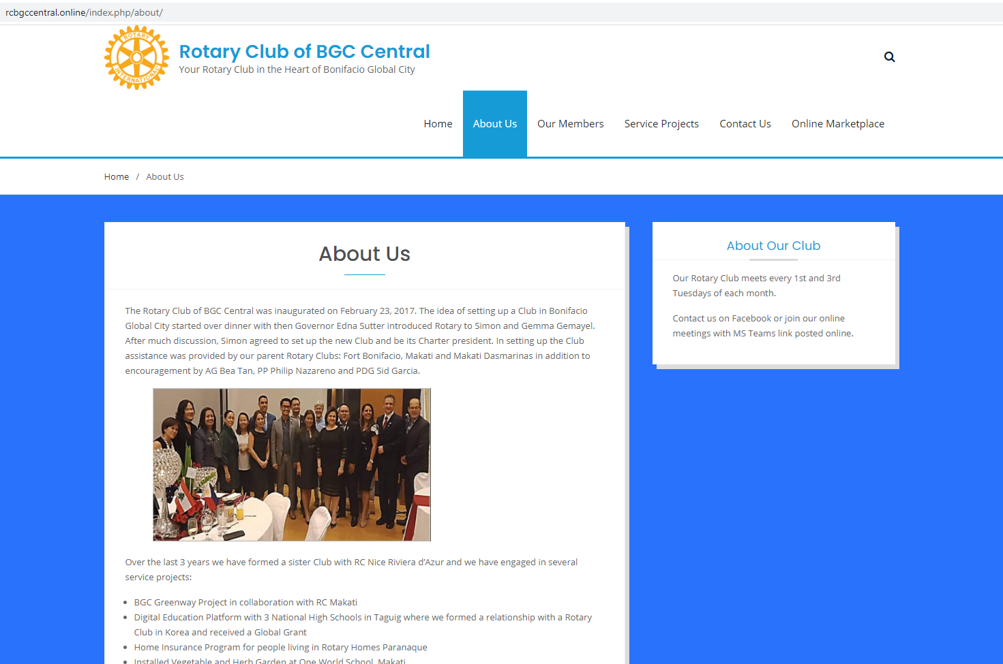
President’s Corner: www.rcbgccentral.online
Website:
LANDING PAGE:
  Welcome Message
  Schedule of meetings
  Scrolling online auctions
  Links to Rotary International
ABOUT US:
  Charter of the Club
  Our Story
Notes:
Mental Health Initiatives:
1. This service project will be renamed as Wellness, Leadership and Mentoring Forurms
A. This will allow for more flexibility and in the types of initiatives and online delivery of the phases/modules
B. This can shift to more online/virtual service delivery to participants
2. The starting point for this service project is to solicit from our members an inventory of backgrounds and knowledge surrounding wellness, leadership and mentoring.
A. Rtn Donna will initiate a document to distribute through the membership base to identify areas of knowledge and expertise surrounding the service project so members can act as resource speakers and/or moderators in the planned forums.
B. Members will submit their profiles in the distributed documents, and can identify key themes and strengths of the members in conducting the forum.
3. A good starting point is to carry out the service projects with our newly formed Rotaract Club, that mainly comprises of collegiate age members from Enderun Colleges.
A. The service project committee for Wellness, Leadership and Mentoring will work with Rotaract to guide them in the strengthening and formation of their club.
B. Identify needs of our Rotaract club in the areas of Wellness, Leadership and Mentoring
C. Attend Rotaract Club meetings on a monthly basis to gather information from the members.
D. Plan and schedule an online forum, in the form of a “coffee table chat” with the interested members of Rotaract.
4. Once the Online Forums have been defined and refined for the needs of the Rotaract members, the service project can possibly expand to other Rotaract Clubs in the district, or other demographics in the community that would like to participate in such online forums.

Slide 10
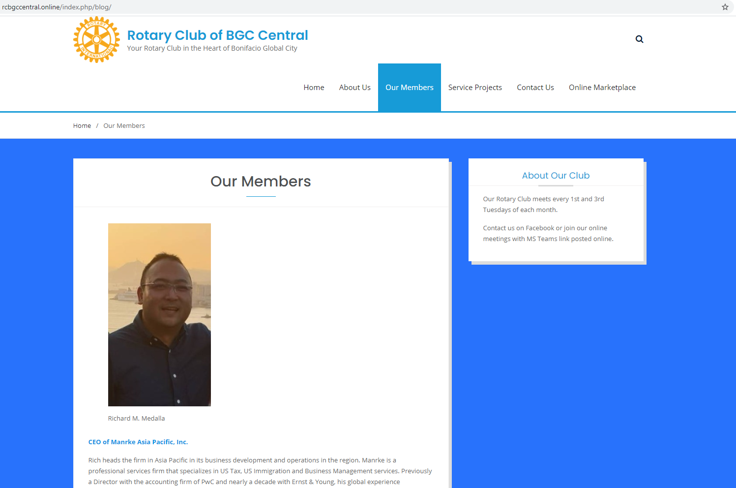
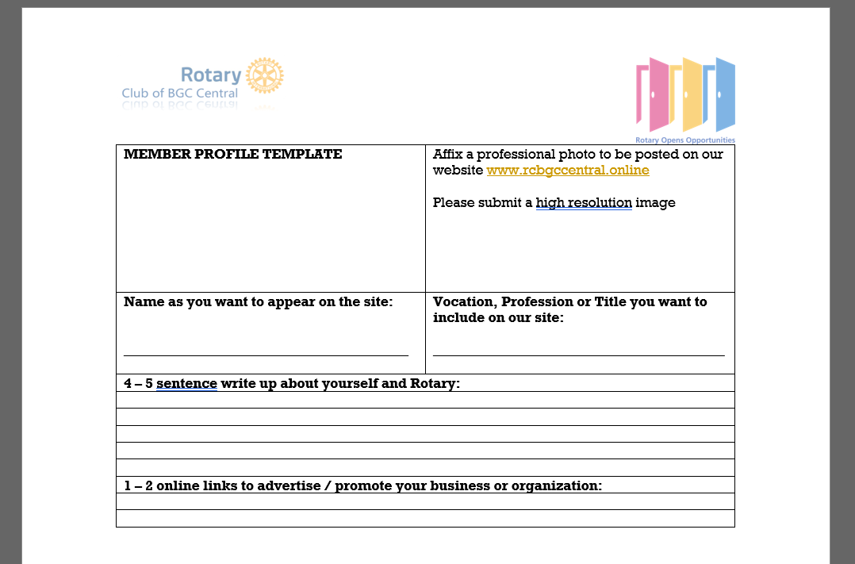
President’s Corner: rcbgccentral.online
Website:
OUR MEMBERS:
  Member Name and Photo
  Vocation/Profession/Business
  Link/Advertise your Business and Organization
  Refer to Template for Member Profiles
Notes:
Mental Health Initiatives:
1. This service project will be renamed as Wellness, Leadership and Mentoring Forurms
A. This will allow for more flexibility and in the types of initiatives and online delivery of the phases/modules
B. This can shift to more online/virtual service delivery to participants
2. The starting point for this service project is to solicit from our members an inventory of backgrounds and knowledge surrounding wellness, leadership and mentoring.
A. Rtn Donna will initiate a document to distribute through the membership base to identify areas of knowledge and expertise surrounding the service project so members can act as resource speakers and/or moderators in the planned forums.
B. Members will submit their profiles in the distributed documents, and can identify key themes and strengths of the members in conducting the forum.
3. A good starting point is to carry out the service projects with our newly formed Rotaract Club, that mainly comprises of collegiate age members from Enderun Colleges.
A. The service project committee for Wellness, Leadership and Mentoring will work with Rotaract to guide them in the strengthening and formation of their club.
B. Identify needs of our Rotaract club in the areas of Wellness, Leadership and Mentoring
C. Attend Rotaract Club meetings on a monthly basis to gather information from the members.
D. Plan and schedule an online forum, in the form of a “coffee table chat” with the interested members of Rotaract.
4. Once the Online Forums have been defined and refined for the needs of the Rotaract members, the service project can possibly expand to other Rotaract Clubs in the district, or other demographics in the community that would like to participate in such online forums.

Slide 11
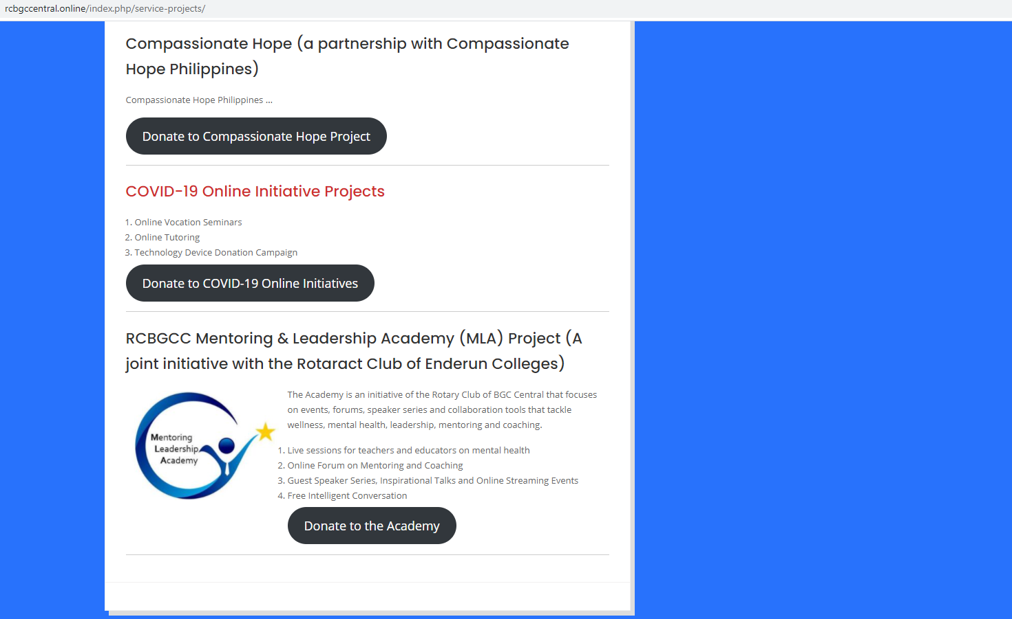
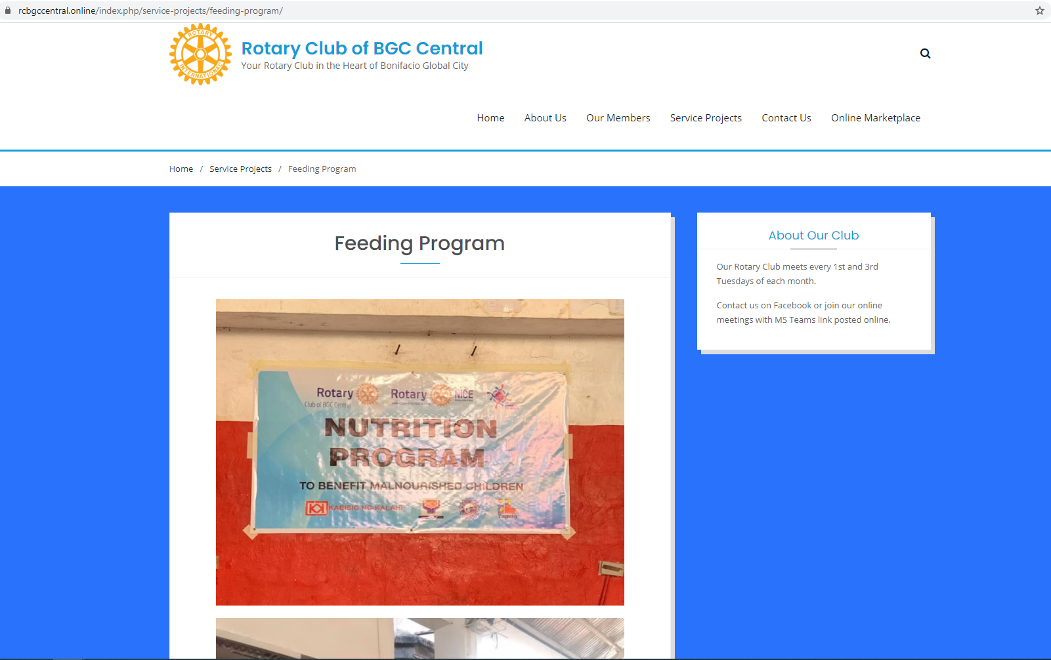
President’s Corner: rcbgccentral.online
Website:
SERVICE PROJECTS:
  Detailed write-up of our Service Projects
  Justpay.to link for sourcing contributions
  Crowdsourcing links
  Online Marketplace
Notes:
Mental Health Initiatives:
1. This service project will be renamed as Wellness, Leadership and Mentoring Forurms
A. This will allow for more flexibility and in the types of initiatives and online delivery of the phases/modules
B. This can shift to more online/virtual service delivery to participants
2. The starting point for this service project is to solicit from our members an inventory of backgrounds and knowledge surrounding wellness, leadership and mentoring.
A. Rtn Donna will initiate a document to distribute through the membership base to identify areas of knowledge and expertise surrounding the service project so members can act as resource speakers and/or moderators in the planned forums.
B. Members will submit their profiles in the distributed documents, and can identify key themes and strengths of the members in conducting the forum.
3. A good starting point is to carry out the service projects with our newly formed Rotaract Club, that mainly comprises of collegiate age members from Enderun Colleges.
A. The service project committee for Wellness, Leadership and Mentoring will work with Rotaract to guide them in the strengthening and formation of their club.
B. Identify needs of our Rotaract club in the areas of Wellness, Leadership and Mentoring
C. Attend Rotaract Club meetings on a monthly basis to gather information from the members.
D. Plan and schedule an online forum, in the form of a “coffee table chat” with the interested members of Rotaract.
4. Once the Online Forums have been defined and refined for the needs of the Rotaract members, the service project can possibly expand to other Rotaract Clubs in the district, or other demographics in the community that would like to participate in such online forums.

Slide 12
President’s Corner: Board Meeting
Sept 26th Board Meeting
Service Projects
Membership
  New Membership Offering
Officers and Chair Report
Secretary
Treasurer
Club Admin
Public Image and Service Projects
Foundation
Membership
Notes:
Mental Health Initiatives:
1. This service project will be renamed as Wellness, Leadership and Mentoring Forurms
A. This will allow for more flexibility and in the types of initiatives and online delivery of the phases/modules
B. This can shift to more online/virtual service delivery to participants
2. The starting point for this service project is to solicit from our members an inventory of backgrounds and knowledge surrounding wellness, leadership and mentoring.
A. Rtn Donna will initiate a document to distribute through the membership base to identify areas of knowledge and expertise surrounding the service project so members can act as resource speakers and/or moderators in the planned forums.
B. Members will submit their profiles in the distributed documents, and can identify key themes and strengths of the members in conducting the forum.
3. A good starting point is to carry out the service projects with our newly formed Rotaract Club, that mainly comprises of collegiate age members from Enderun Colleges.
A. The service project committee for Wellness, Leadership and Mentoring will work with Rotaract to guide them in the strengthening and formation of their club.
B. Identify needs of our Rotaract club in the areas of Wellness, Leadership and Mentoring
C. Attend Rotaract Club meetings on a monthly basis to gather information from the members.
D. Plan and schedule an online forum, in the form of a “coffee table chat” with the interested members of Rotaract.
4. Once the Online Forums have been defined and refined for the needs of the Rotaract members, the service project can possibly expand to other Rotaract Clubs in the district, or other demographics in the community that would like to participate in such online forums.

Slide 13


UPDATE
Rotaract Club of Enderun Colleges President: Francine Geli
For RY 2020-2021: Open invite to join Rotary Club Meetings 1st and 3rd Tuesdays monthly
PLANS:
  Monthly Meetings
  Assist with Vocation Seminar / Online Career Talks
  Website Development
    Content Development
    Online Fundraising / Auctions
    Content Management
  Leadership & Mentoring
    Scheduled for 17 SEP 2020 THURS
  Service Projects

Slide 14
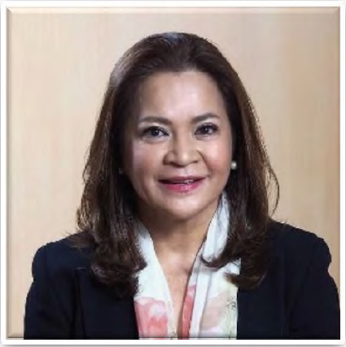
Guest Speaker: Ruby Jacob
Ruby Jacob is Executive Director for Business Development at ZMG Ward Howell, with a focus on developing new strategic partnerships with Philippine, ASEAN, and international businesses.
She is responsible for key account management of several big Philippine businesses and has assisted in the placement of C-suite talents in leadership roles of companies/conglomerates in various sectors, including – but not limited to – Power & Energy, Infrastructure, Real Estate, Consumer Goods, as well as Manning & Crewing.
Prior to joining ZMG Ward Howell, Ruby championed Project Management, Business Development and Strategic Planning through her experience in various foreign companies across several industries. She was Project Manager at Copasetic Holdings, Ltd. (Cayman Islands), Executive Vice President of The Friedli Group (Miami), Destination Consultant for Full Circle International (Washington, DC), and Vice President of Particular Holdings, Ltd. (Channel Islands).
Ruby earned her MBA from Institut European d’Administration des Affaires (INSEAD), and her Business Management degree from the University of the Philippines.
Ruby speaks English, German, French, and Spanish.

Slide 15

Membership Dialogue
Quick updates from our members
  Life or
  Business or
  Family or
  Activities
  Etc.

Slide 16


District Announcements
World Polio Day (October 24th)
Polio Now T-Shirts on Sale
RC Makati Dasma: New Ventures Speaker (October 7th)
RC Makati Poblacion: Search for Hometown Heroes Nomination (October 10th Deadline)

Slide 17
Adjournment / Reminders
Member Profile templates for Website and Mentoring Initiative
Next Club Meeting: Oct 20th, 7 pm (L’Entrecote and ONLINE)
  Service Projects
  Guest Speaker
  Classification Talk
Rotary Convention 2021: Taipei, Taiwan Registration Ongoing

