Slide 1
Club Meeting
Club No. 88249
Rotary Club of Bonifacio Global City Central
17 NOVEMBER 2020
Virtual Meeting via MS Teams and Live Meeting at L’Entrecote Bistro

Slide 2
Club Meeting Schedule
20:00
Call to Order
20:05
Invocation / Anthem
20:10
Welcome Remarks
20:15
Club Officers Reporting
20:45
Vocational Speaker Lineup
21:00
Membership Dialogue
21:15
Announcements
Reminders
Updates
21:30
Adjournment
President’s Corner
Secretary’s Notes
Treasurer’s Time
Club Admin’s Segment

Slide 3









Invocation / National Anthem
Creator and sustainer of all that is or will ever be, accept our thanks for this day and all its blessings. We ask that you guide and direct our club, its leaders and our actions. Grant that each of us may feel our responsibility to Rotary, to our community, to our country, and indeed to all countries and peoples. Bless our meeting and fellowship today, in your service. Amen.

Slide 4
Welcome
Guests and Visiting Rotarians
  Francine Geli – Rotaract Club President
  Rotaractors in attendance
  Visitors

Slide 5
Club Officers Reporting
President – PVP Rich
Secretary – open position
Treasurer – Rtn Amal
Club Admin – Rtn Janet

Slide 6
President’s Corner
Service Projects Updates
  Compassionate Hope
    seeds / vegetable garden
  Mentoring & Leadership Academy
  BGC Greenway
  Digital Learning Boards
  Vocation Seminars / Online Tutoring
  MOU with RC Makati to promote voter registration
  Typhoon Relief
Fundraising
  Online auction – content to Rotaract
  Crowdsourcing – obtain member volunteers to prepare detailed write-ups of service projects; utilize justpay.to link for donations
  Online Marketplace for communities in need (Tienda Della Strada and Buy Pinoy)

Slide 7
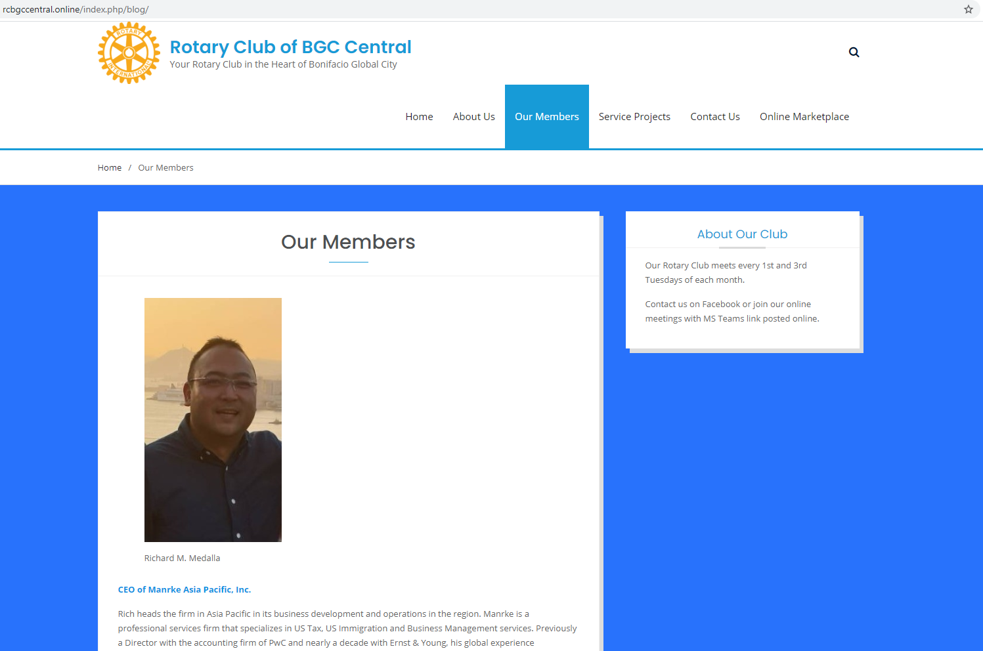
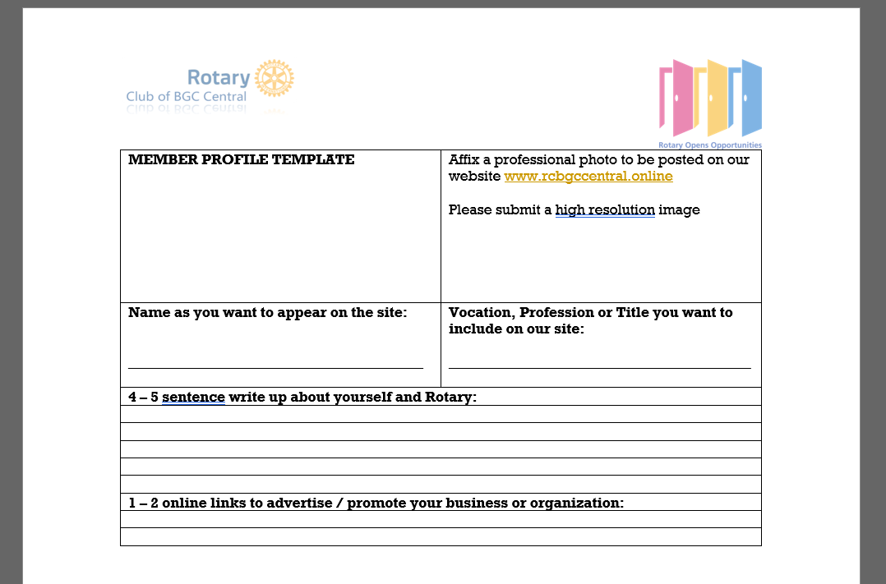
President’s Corner: rcbgccentral.online
Website:
OUR MEMBERS:
  Member Name and Photo
  Vocation/Profession/Business
  Link/Advertise your Business and Organization
  Refer to Template for Member Profiles
Notes:
Mental Health Initiatives:
1. This service project will be renamed as Wellness, Leadership and Mentoring Forurms
A. This will allow for more flexibility and in the types of initiatives and online delivery of the phases/modules
B. This can shift to more online/virtual service delivery to participants
2. The starting point for this service project is to solicit from our members an inventory of backgrounds and knowledge surrounding wellness, leadership and mentoring.
A. Rtn Donna will initiate a document to distribute through the membership base to identify areas of knowledge and expertise surrounding the service project so members can act as resource speakers and/or moderators in the planned forums.
B. Members will submit their profiles in the distributed documents, and can identify key themes and strengths of the members in conducting the forum.
3. A good starting point is to carry out the service projects with our newly formed Rotaract Club, that mainly comprises of collegiate age members from Enderun Colleges.
A. The service project committee for Wellness, Leadership and Mentoring will work with Rotaract to guide them in the strengthening and formation of their club.
B. Identify needs of our Rotaract club in the areas of Wellness, Leadership and Mentoring
C. Attend Rotaract Club meetings on a monthly basis to gather information from the members.
D. Plan and schedule an online forum, in the form of a “coffee table chat” with the interested members of Rotaract.
4. Once the Online Forums have been defined and refined for the needs of the Rotaract members, the service project can possibly expand to other Rotaract Clubs in the district, or other demographics in the community that would like to participate in such online forums.

Slide 8
President’s Corner: Board Meeting
Sept 26th Board Meeting
Service Projects
Membership
  New Membership Offering
Officers Elect
President
Secretary
Treasurer
Club Admin
Public Image and Service Projects
Foundation
Membership
Notes:
Mental Health Initiatives:
1. This service project will be renamed as Wellness, Leadership and Mentoring Forurms
A. This will allow for more flexibility and in the types of initiatives and online delivery of the phases/modules
B. This can shift to more online/virtual service delivery to participants
2. The starting point for this service project is to solicit from our members an inventory of backgrounds and knowledge surrounding wellness, leadership and mentoring.
A. Rtn Donna will initiate a document to distribute through the membership base to identify areas of knowledge and expertise surrounding the service project so members can act as resource speakers and/or moderators in the planned forums.
B. Members will submit their profiles in the distributed documents, and can identify key themes and strengths of the members in conducting the forum.
3. A good starting point is to carry out the service projects with our newly formed Rotaract Club, that mainly comprises of collegiate age members from Enderun Colleges.
A. The service project committee for Wellness, Leadership and Mentoring will work with Rotaract to guide them in the strengthening and formation of their club.
B. Identify needs of our Rotaract club in the areas of Wellness, Leadership and Mentoring
C. Attend Rotaract Club meetings on a monthly basis to gather information from the members.
D. Plan and schedule an online forum, in the form of a “coffee table chat” with the interested members of Rotaract.
4. Once the Online Forums have been defined and refined for the needs of the Rotaract members, the service project can possibly expand to other Rotaract Clubs in the district, or other demographics in the community that would like to participate in such online forums.

Slide 9


UPDATE
Rotaract Club of Enderun Colleges President: Francine Geli
For RY 2020-2021: Open invite to join Rotary Club Meetings 1st and 3rd Tuesdays monthly
PLANS:
  Monthly Meetings
  Assist with Vocation Seminar / Online Career Talks
  Website Development
    Content Development
    Online Fundraising / Auctions
    Content Management
  Leadership & Mentoring
    Scheduled for 17 SEP 2020 THURS
  Service Projects

Slide 10
Vocation Speaker Lineup
?
?
?

Slide 11

Membership Dialogue
Quick updates from our members
  Life or
  Business or
  Family or
  Activities
  Etc.

Slide 12
District Announcements
District Disaster Management Committee seeking donations (1k to 56k range)
Regional Rotary Foundation Seminar Nov 21 19:30 virtual meeting

Slide 13
Adjournment / Reminders
Member Profile templates for Website and Mentoring Initiative
Next Club Meeting: Dec 1st, 7 pm (L’Entrecote and ONLINE)
  Governor’s Visit
  Officer Induction
Virtual Christmas Party / Online Fellowship - ??
Rotary Convention 2021: Taipei, Taiwan Registration Ongoing

