Slide 1
District Governor’s Visit & Club Induction
Club No. 88249
Rotary Club of Bonifacio Global City Central
01 DECEMBER 2020 | 7 pm Manila Time
Virtual Meeting via MS Teams

Slide 2
Governor’s Visit & Club Induction Schedule
19:00 Gov Visit
With Officers and Directors:
> Audio Visual Presentation
19:30 Induction Program
> Call to Order
> Invocation
> National Anthem/4-Way Test
19:45
Welcome Remarks
Introduction of Dignitaries and Guests
20:00
Charging of Officers
Oath of Office
20:15
Introduction of PVP
Inaugural Speech of PVP
20:40
Charging of New Member
Oath of Membership
21:00
Introduction of Guest of Honor
Inspirational Message
21:30
Adjournment
> Club Projects
> AG Remarks
> Gov Comments

Slide 3

Governor’s Visit Program
Audio Visual Presentation
Club Projects
Assistant Governor Dwight Agulan Remarks
District 3830 Governor Chacha Camacho

Slide 4
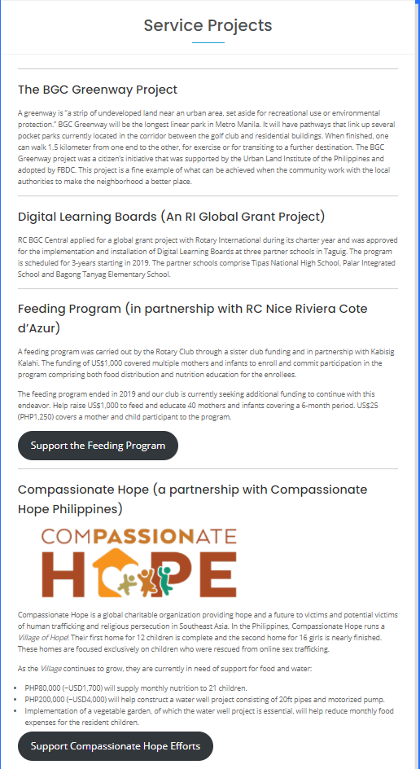
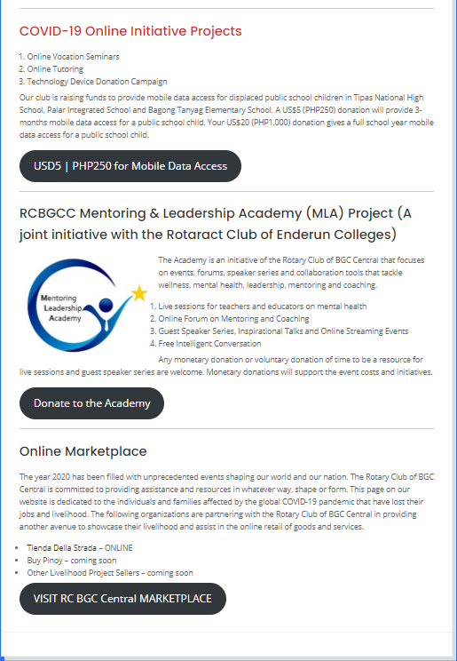
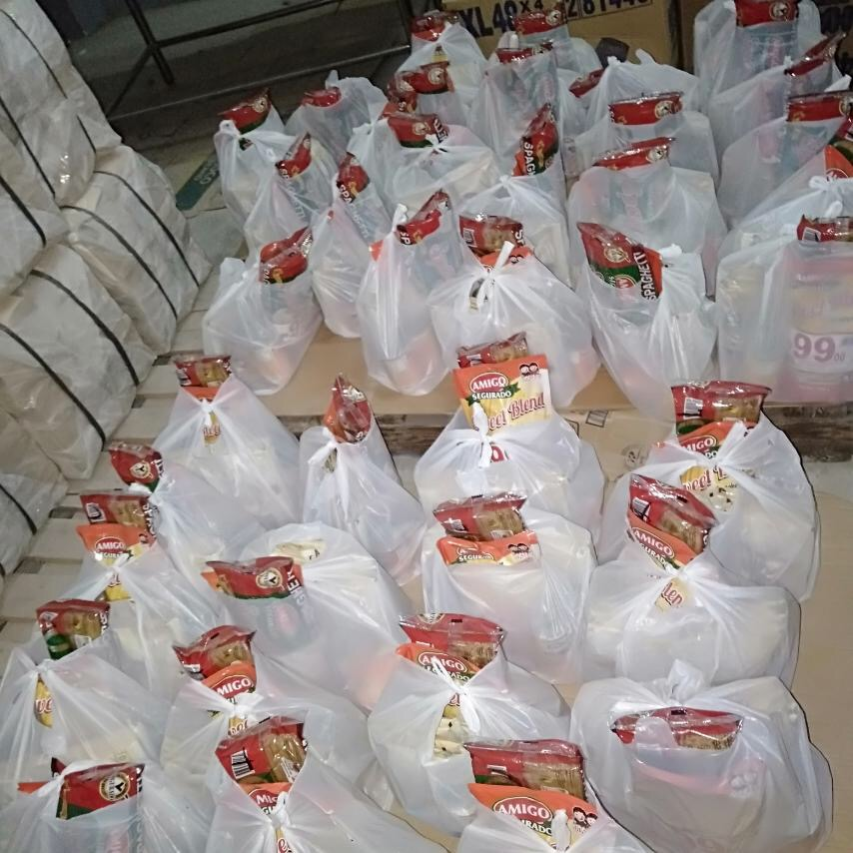
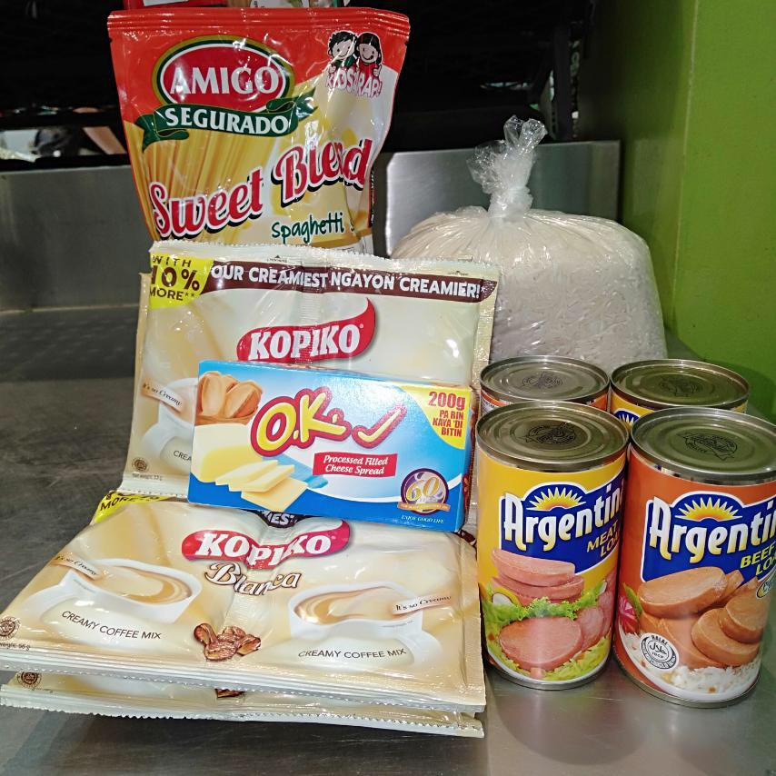
Governor’s Visit Program: Club Projects

Slide 5
Governor’s Visit Program
Club Projects
  BGC Greenway
  Digital Learning Boards
  Compassionate Hope Vegetable Garden
  Covid-19 Online Initiatives
  Relief Efforts (Marikina and Bicol)
  Mentoring & Leadership Academy (Online Forums and Speaker Series)
Assistant Governor Dwight Agulan Remarks
District 3830 Governor Chacha Camacho

Slide 6
Club Projects
Service Projects Updates
  Compassionate Hope
    seeds / vegetable garden
  Mentoring & Leadership Academy
  BGC Greenway
  Digital Learning Boards
  Vocation Seminars / Online Tutoring
  MOU with RC Makati to promote voter registration
  Typhoon Relief
Fundraising/Online Initiatives
  Online auction – content to Rotaract
  Online Marketplace for communities in need (Tienda Della Strada and Buy Pinoy)

Slide 7

Club Induction Program

Slide 8
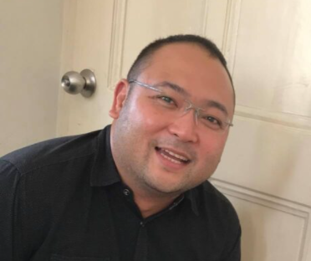

Call to Order
PVP Rich Medalla

Slide 9
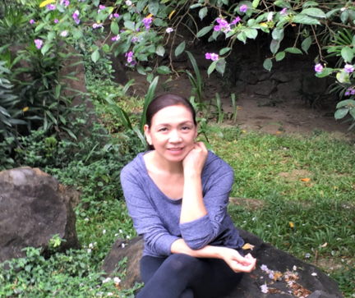
Invocation
Rotarian Ofelia Montallana-Orcales

Slide 10





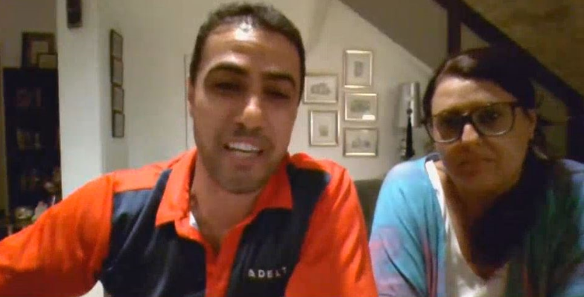

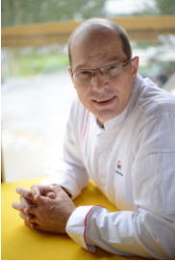
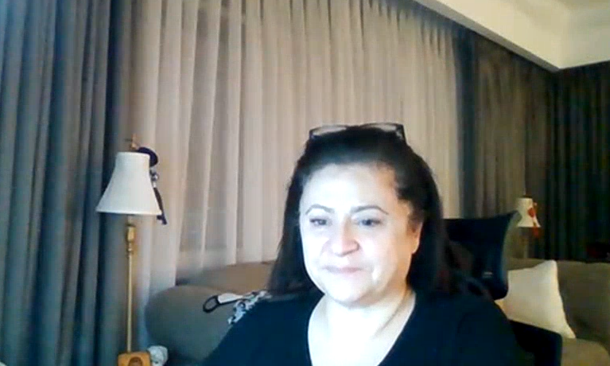
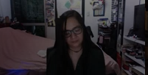
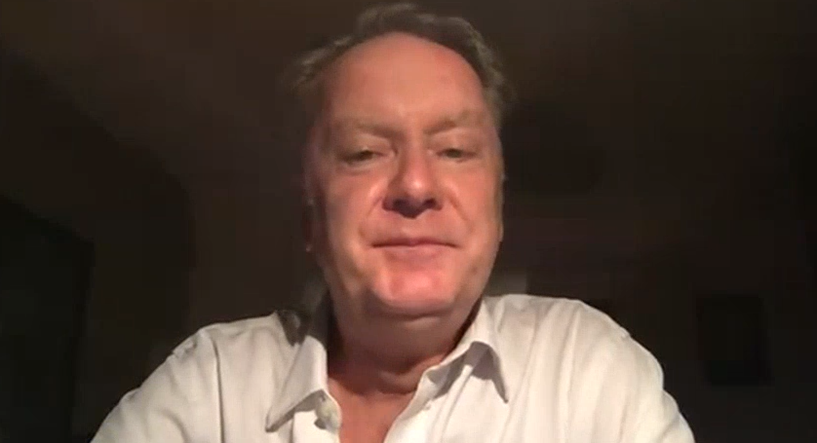

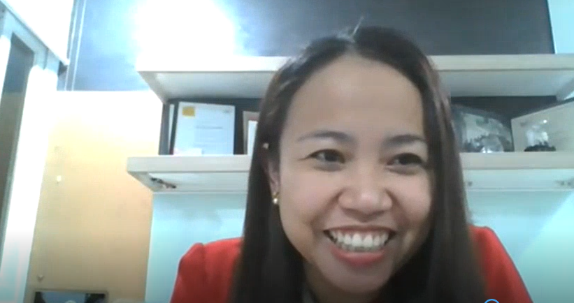

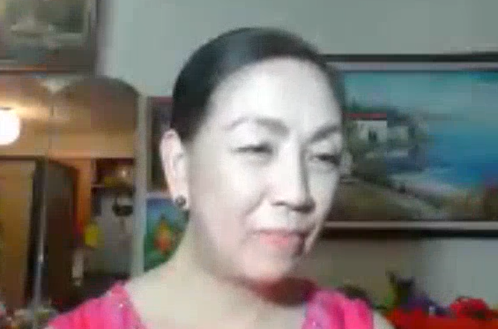


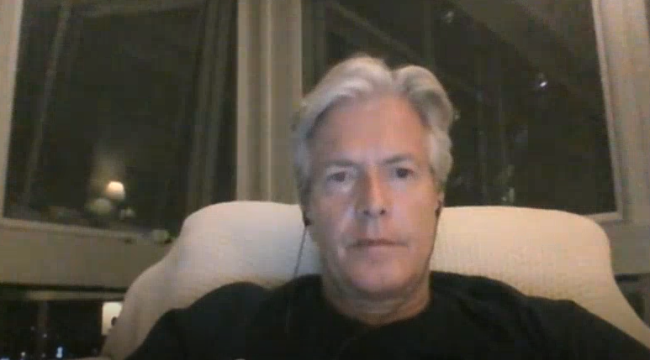


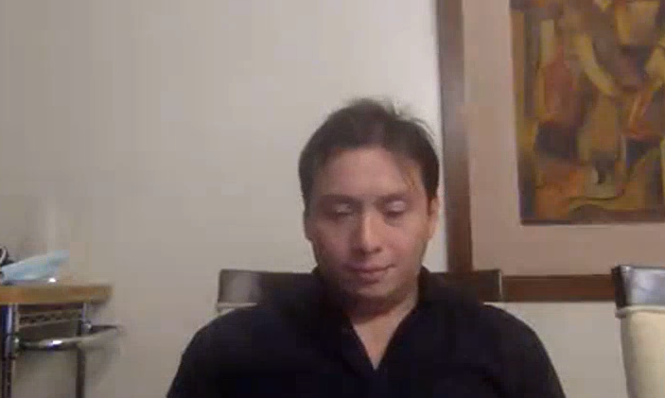
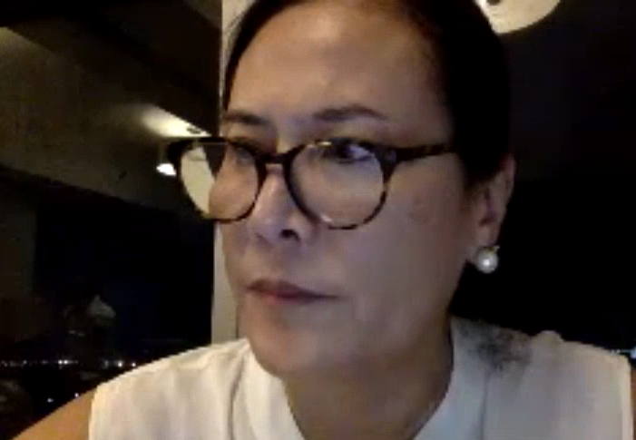
National Anthem
Rotarian Martin Kaspar
https://youtu.be/-FUBJY6nco0

Slide 11
The Four Way Test

Slide 12
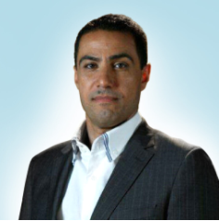
Welcome Remarks
Guests and Visiting Rotarians
  District Governor Chacha Camacho
  Past District Governor Edwin Afzelius
  Past District Governor Sonny Coloma
  Assistant Governor Dwight Agulan
  Fellow Rotarians
  Rotaractors in attendance
  Visitors
IPP Gabriel Georgy

Slide 13
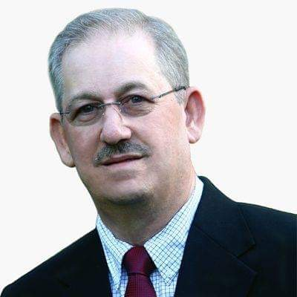
Charging of Club Officers RY 2020-2021
President – PVP Rich Medalla
Treasurer – Rtn Amal Hakki
Club Admin – Rtn Janet Webster
Foundation Chair – IPP Gabe Georgy
Public Image and Service Projects Co-Chairs – Rtn Ofelia Orcales and Rtn Donna Georgy
Membership Chair – Cora Padiernos
PDG Edwin Afzelius

Slide 14
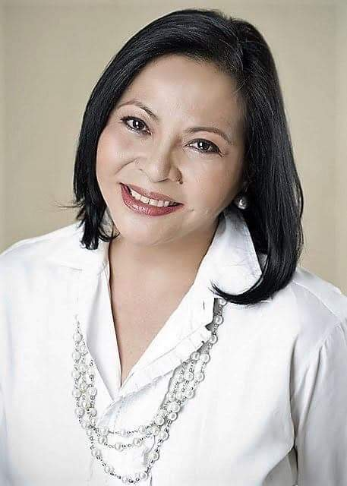
Oath of Office RY 2020-2021
District Governor Chacha Camacho

Slide 15
Oath of Office RY 2020-2021
OATH OF OFFICE
I, (State your name) do solemnly swear that I will faithfully execute the office of (State your position) of the Rotary Club of BGC Central, that I will uphold the constitution and bylaws of RI and of this club.
I will, to the best of my ability, give support and assistance to Rotary International & to the District, this obligation which I impose upon myself voluntarily.
I will always be mindful to measure everything I think, say or do by the 4 Way Test, ever applying our motto Service Above Self.
I promise to pool all our energies together to improve our club members’ Rotary journey experience and to open opportunities to serve and to enjoy Rotary.
I further swear to Lead with my Rotarian heart. All these I promise to do and observe without mental reservation or purpose of evasion. SO HELP ME GOD.

Slide 16
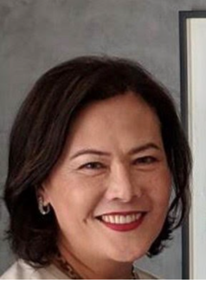
Introduction of Perfect Vision President
Rotarian Cora Padiernos

Slide 17
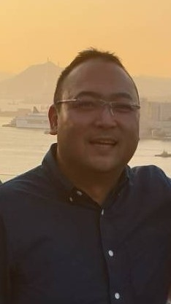

Inaugural Speech of Perfect Vision President
PVP Rich Medalla
Growing Up Rotary
Global Reach
My Local Club
How we do things in RCBGCC

Slide 18
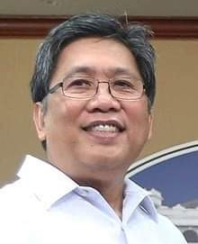
Charging of New Members
PDG Sonny Coloma
RC BGC Central New Member(s)
  Salvatore La Valle

Slide 19
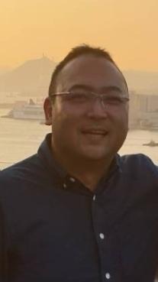
Oath of Membership
PVP Rich Medalla

Slide 20
Oath of Membership
OATH OF MEMBERSHIP
I, (STATE YOUR NAME), having been inducted as a member of the (Rotary Club of BGC Central), do solemnly swear, that I will abide by, follow and uphold, all the provisions of the Constitution and By-laws of Rotary International and my club; and fulfill to the best of my ability all the duties and responsibilities of my membership.
I pledge to advance the Object of Rotary and to exemplify Rotary’s maxim: SERVICE ABOVE SELF.
I further swear to promote awareness of the theme of Rotary International in Rotary Year 2020 – 2021, “ROTARY OPENS OPPORTUNITIES”.
All these I pledge freely and voluntarily, without any mental reservation or purpose of evasion.
So help me God.

Slide 21
Introduction of Guest of Honor
PVP Rich Medalla

Slide 22
Inspirational Message
District Governor Chacha Camacho

Slide 23
Adjournment
PVP Rich Medalla

