Slide 1
Club Meeting
Club No. 88249
Rotary Club of Bonifacio Global City Central
04 MAY 2021
Virtual Meeting via MS Teams

Slide 2
Club Meeting Schedule
19:30
Call to Order
19:35
Invocation / Anthem
19:40
Welcome Remarks
19:45
Club Officers Reporting
20:00
Club Project Review
20:10
Membership Dialogue
20:20
Announcements
Reminders
Updates
20:30
Adjournment
President’s Corner
Secretary’s Notes
Treasurer’s Time
Club Admin’s Segment

Slide 3









Invocation / National Anthem
As we gather here today as members of Rotary, we pray that we are ever mindful of opportunities to render our service to fellow citizens and to our community. Keeping in mind always the enduring values of life, exerting our efforts in those areas and on those things upon which future generations can build with confidence. Let us continue to strive to make a better world. Amen.

Slide 4
Welcome
Guests and Visiting Rotarians

Slide 5
Club Officers Reporting
President
Secretary
Treasurer
Club Admin

Slide 6
President’s Corner
Service Projects Updates
  Compassionate Hope
  Mentoring & Leadership Academy
  BGC Greenway
  Digital Learning Boards
  Vocation Seminars / Online Tutoring
  MOU with RC Makati to promote voter registration
  Typhoon Relief
Fundraising
  Online auction – content to Rotaract
  Crowdsourcing – obtain member volunteers to prepare detailed write-ups of service projects; utilize justpay.to link for donations
  Online Marketplace for communities in need (Tienda Della Strada and Buy Pinoy)
Notes:
RM to line up speakers, HS contact, GG update

Slide 7
President’s Corner
Compassionate Hope – May 8th
  11 am
  Address is 1 Roman Rojas Road, Abuyod, Antipolo.
  You can search Abuyod National High School to make sure it is taking you to Roman Rojas Rd.
  The tricky part: You will enter Roman Rojas at may-iba once you come to the bottom of the mountain at sharp right turn bear left you will see a Alfa- Mart
  Our new Line Here – 02 86583671
Club Site Visit Lunch
  Vieux Chalet
  456 Taktak Road, Antipolo, Rizal
Mentoring & Leadership Academy
  PH Tax Update – May 18th
  COVID Update – June 1st
Notes:
RM to line up speakers, HS contact, GG update

Slide 8
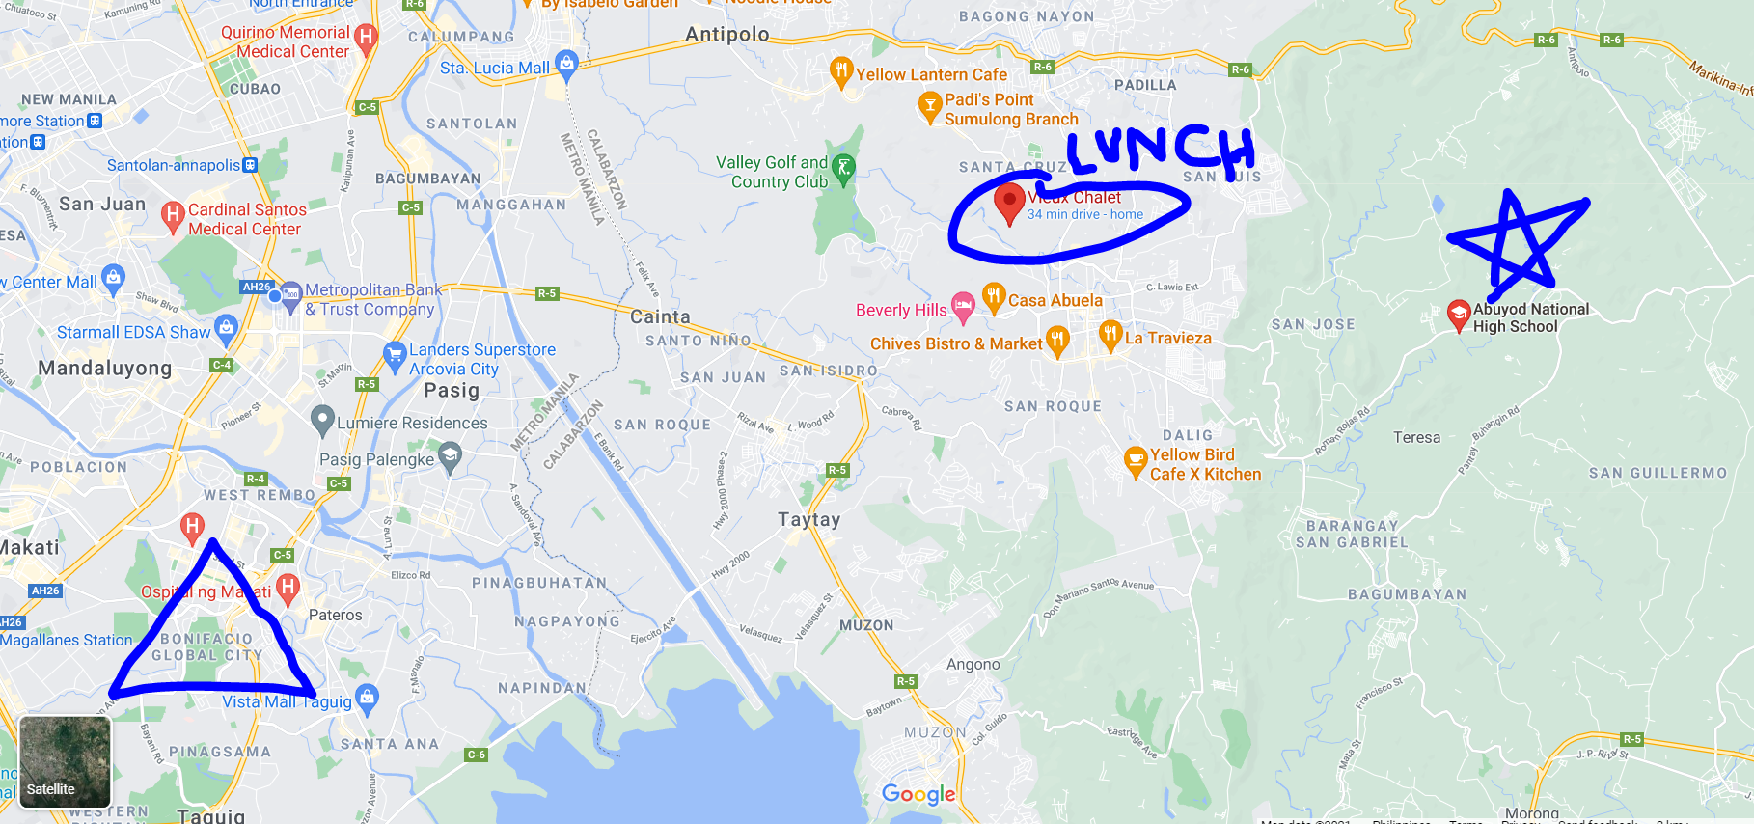
Site Visit

Slide 9

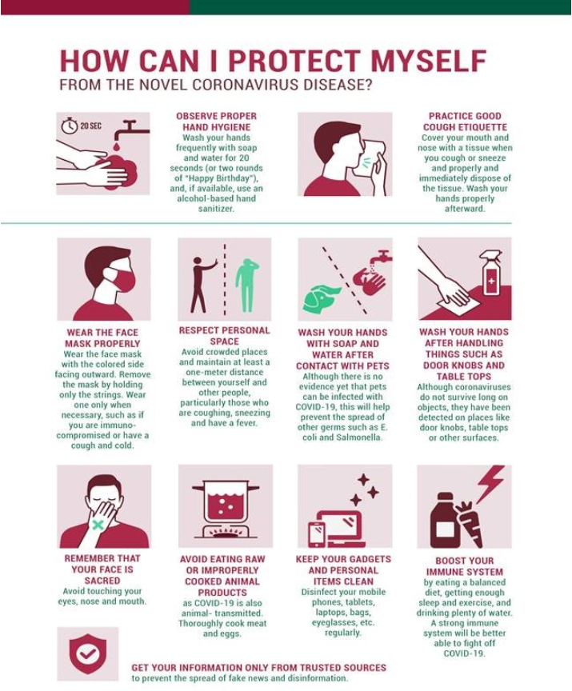
Mentoring & Leadership Academy
PH Tax Update (May 18)
COVID Update (June 1)

Slide 10
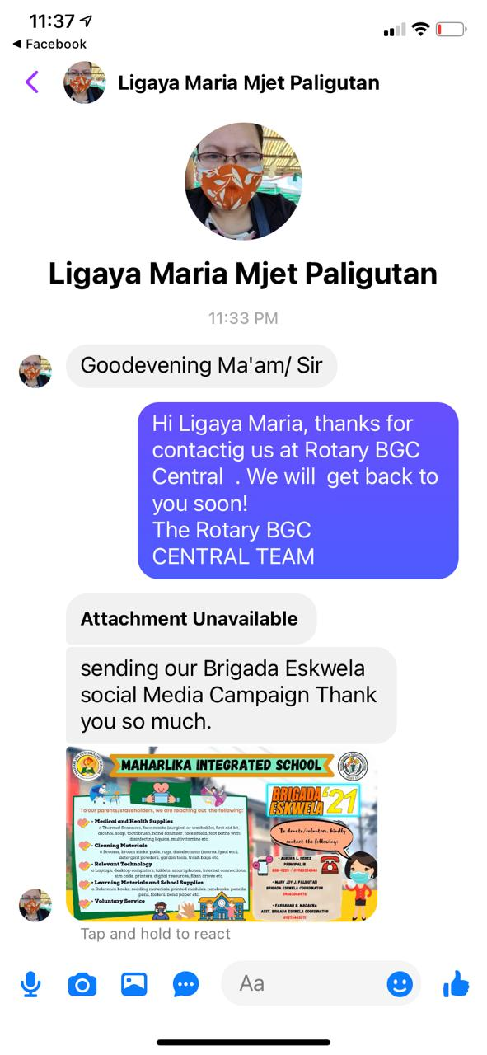
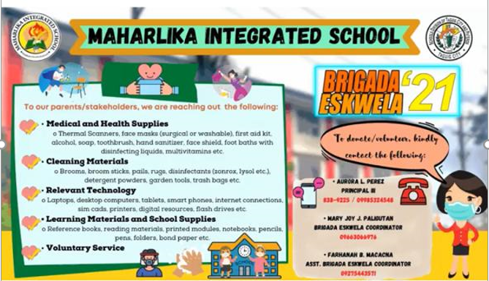
Maharlika Integrated School Requests

Slide 11

President’s Corner: Upcoming RY
*Officers Elect
President
Secretary
Treasurer
Club Admin
Public Image and Service Projects
Foundation
Membership
*Semi-Annual Dues
Notes:
Mental Health Initiatives:
1. This service project will be renamed as Wellness, Leadership and Mentoring Forurms
A. This will allow for more flexibility and in the types of initiatives and online delivery of the phases/modules
B. This can shift to more online/virtual service delivery to participants
2. The starting point for this service project is to solicit from our members an inventory of backgrounds and knowledge surrounding wellness, leadership and mentoring.
A. Rtn Donna will initiate a document to distribute through the membership base to identify areas of knowledge and expertise surrounding the service project so members can act as resource speakers and/or moderators in the planned forums.
B. Members will submit their profiles in the distributed documents, and can identify key themes and strengths of the members in conducting the forum.
3. A good starting point is to carry out the service projects with our newly formed Rotaract Club, that mainly comprises of collegiate age members from Enderun Colleges.
A. The service project committee for Wellness, Leadership and Mentoring will work with Rotaract to guide them in the strengthening and formation of their club.
B. Identify needs of our Rotaract club in the areas of Wellness, Leadership and Mentoring
C. Attend Rotaract Club meetings on a monthly basis to gather information from the members.
D. Plan and schedule an online forum, in the form of a “coffee table chat” with the interested members of Rotaract.
4. Once the Online Forums have been defined and refined for the needs of the Rotaract members, the service project can possibly expand to other Rotaract Clubs in the district, or other demographics in the community that would like to participate in such online forums.

Slide 12
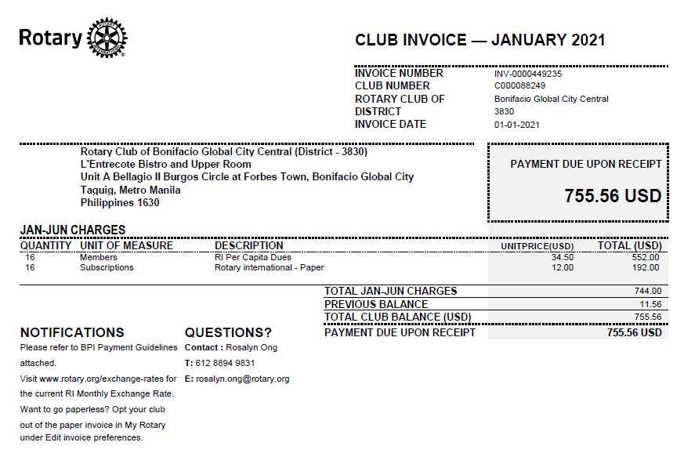
Treasurer’s Time: Club Invoice
Our 2nd Semester Invoice is PAID
Reminder on Club Dues
Paul Harris Fellow RY 2021 - $1,000
Notes:
Mental Health Initiatives:
1. This service project will be renamed as Wellness, Leadership and Mentoring Forurms
A. This will allow for more flexibility and in the types of initiatives and online delivery of the phases/modules
B. This can shift to more online/virtual service delivery to participants
2. The starting point for this service project is to solicit from our members an inventory of backgrounds and knowledge surrounding wellness, leadership and mentoring.
A. Rtn Donna will initiate a document to distribute through the membership base to identify areas of knowledge and expertise surrounding the service project so members can act as resource speakers and/or moderators in the planned forums.
B. Members will submit their profiles in the distributed documents, and can identify key themes and strengths of the members in conducting the forum.
3. A good starting point is to carry out the service projects with our newly formed Rotaract Club, that mainly comprises of collegiate age members from Enderun Colleges.
A. The service project committee for Wellness, Leadership and Mentoring will work with Rotaract to guide them in the strengthening and formation of their club.
B. Identify needs of our Rotaract club in the areas of Wellness, Leadership and Mentoring
C. Attend Rotaract Club meetings on a monthly basis to gather information from the members.
D. Plan and schedule an online forum, in the form of a “coffee table chat” with the interested members of Rotaract.
4. Once the Online Forums have been defined and refined for the needs of the Rotaract members, the service project can possibly expand to other Rotaract Clubs in the district, or other demographics in the community that would like to participate in such online forums.

Slide 13
Treasurer’s Time: Club Finances
MetroBank Operating
MetroBank Savings
MetroBank Global Grant
425,855.54
271,834.87
2,049,775.84
Notes:
Mental Health Initiatives:
1. This service project will be renamed as Wellness, Leadership and Mentoring Forurms
A. This will allow for more flexibility and in the types of initiatives and online delivery of the phases/modules
B. This can shift to more online/virtual service delivery to participants
2. The starting point for this service project is to solicit from our members an inventory of backgrounds and knowledge surrounding wellness, leadership and mentoring.
A. Rtn Donna will initiate a document to distribute through the membership base to identify areas of knowledge and expertise surrounding the service project so members can act as resource speakers and/or moderators in the planned forums.
B. Members will submit their profiles in the distributed documents, and can identify key themes and strengths of the members in conducting the forum.
3. A good starting point is to carry out the service projects with our newly formed Rotaract Club, that mainly comprises of collegiate age members from Enderun Colleges.
A. The service project committee for Wellness, Leadership and Mentoring will work with Rotaract to guide them in the strengthening and formation of their club.
B. Identify needs of our Rotaract club in the areas of Wellness, Leadership and Mentoring
C. Attend Rotaract Club meetings on a monthly basis to gather information from the members.
D. Plan and schedule an online forum, in the form of a “coffee table chat” with the interested members of Rotaract.
4. Once the Online Forums have been defined and refined for the needs of the Rotaract members, the service project can possibly expand to other Rotaract Clubs in the district, or other demographics in the community that would like to participate in such online forums.

Slide 14


UPDATE
Rotaract Club of Enderun Colleges President: Francine Geli
For RY 2020-2021: Open invite to join Rotary Club Meetings 1st and 3rd Tuesdays monthly
RYLA – March 6, 2021 (FREE Registration – 2 registered)
PLANS:
  Monthly Meetings
  Assist with Vocation Seminar / Online Career Talks
  Website Development
    Content Development
    Online Fundraising / Auctions
    Content Management
  Service Projects

Slide 15
Vocation Speaker Lineup
Claire
Donna
Liz

Slide 16

Quick Online Fellowship
Team 1
  Round 1 - 9
  Round 2 - 9
  Round 3 - 15
Team 2
  Round 1 - 34
  Round 2 - 0
  Round 3 - 0

Slide 17
Club To Do’s
Re-Engage with Rotaract Club
Global Grant Update Reporting
Bank Signatures and Documentation
Online Vocation Seminar Planning
BGC Community Pantry
Club Walk-Talk at BGC Greenway
P30-50k to Maharlika

Slide 18
Adjournment / Reminders
Member Profile templates for Website and Mentoring Initiative
www.bit.ly/rcbgcc
Next Club Meetings: May 18th and June 1st 7:30 pm (L’Entrecote – if allowed and ONLINE)

