Slide 1

Regular Members Meeting
Club No: 88249
Tuesday 28th January, 18:45-20:00
L’Entrecote, Forbestown, Bonifacio Global City, Manila

Slide 2
God of all Creation,
We seek blessings on the tasks before us.
Bless our efforts with clear insight, our deliberations with wisdom, our work, with clarity and accuracy, and our decisions with impartiality.
Copyright © 2012 Beth McLendon of Inspirational - Prayers
Invocation

Slide 3

National Anthem of The Philippines

Slide 4
Agenda
          Call to Order
          Invocation and National Anthem
          Welcome to our guests
          Recap of Service projects in 2019-2020
          Vocational speaker
          District Events / Activities
          Election of new officers
          Close

Slide 5
Welcome to Our Guests
Special Guests
Ed Tan (prospective member)
New Members
Kevin Panahon
Kamila Bylica

Slide 6

SERVICE PROJECT UPDATES

Slide 7
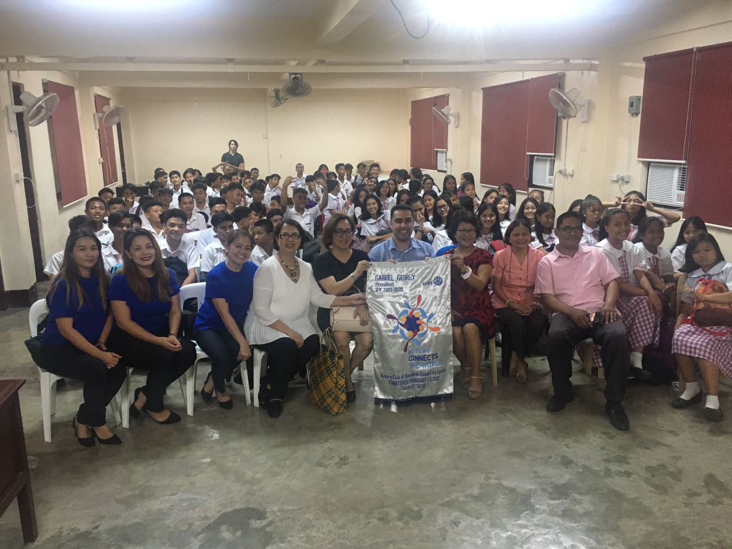
UPDATE ON MENTAL HEALTH INITIATIVE
Mental Health Education
Mentoring & Leadership Academy
Education on Mental Health (depression and suicide)
Collaboration with Philippine Psychiatric Association – President Vanessa Cainhug and Psychotherapists Zenia Panahon and Toni Dy
Tipas National High School,- 3 slots completed
  November 6: 2-5pm (students grade 9)
  November 11: 9:30-12 noon (students grade 10)
  December 6: 2-5pm (teachers/faculty)
Plan to make some changes for next 3 workshops. Cap lecture to 2hrs, delivered by Psychotherapist and remove the Psychiatrist
Mentoring for young leaders by professional coaches
Gemma Gemayel preparing application for a Rotary Global Grant
Multi-stakeholder approach

Slide 8

UPDATE ON INTERACTIVE SMART BOARDS INITIATIVE
Received global grant of USD55k for 3 schools for digital learning platform for interactive white boards.
Program to run for 3-years
Funding for this project came from a global grant of USD50k and the balance of $5k (approx. Php270k) funded by RC BGC Central from existing cash flow.
Separate bank account created for the global grant funds

Slide 9
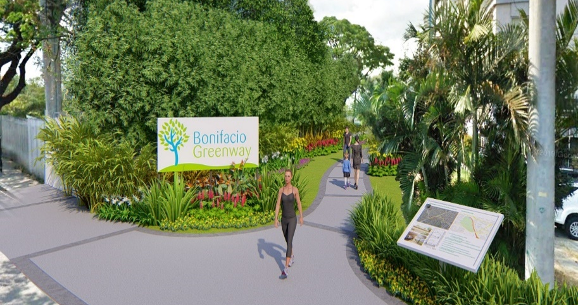
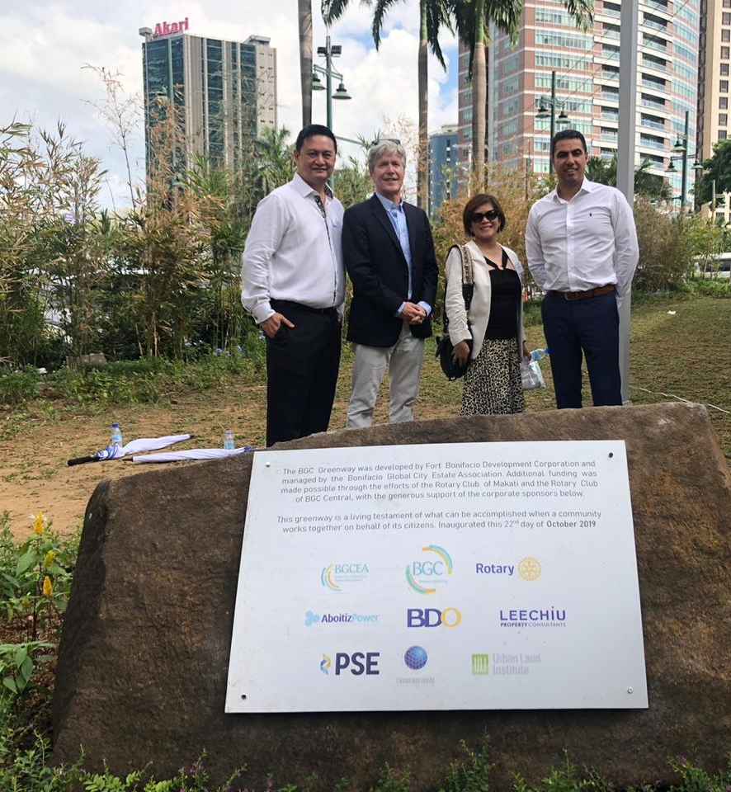
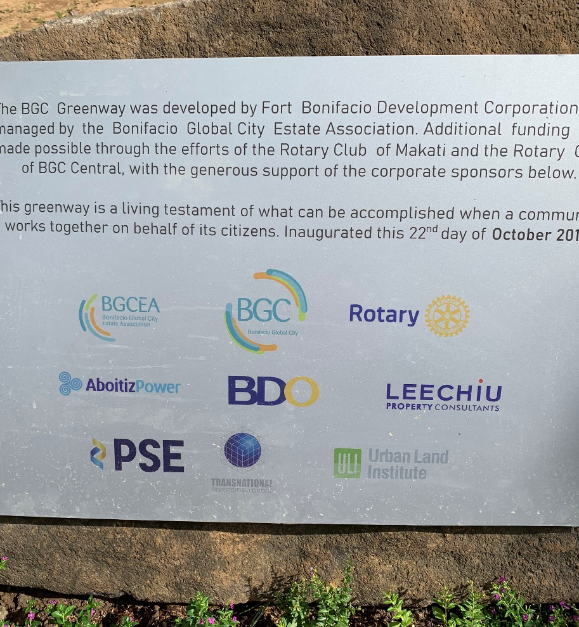
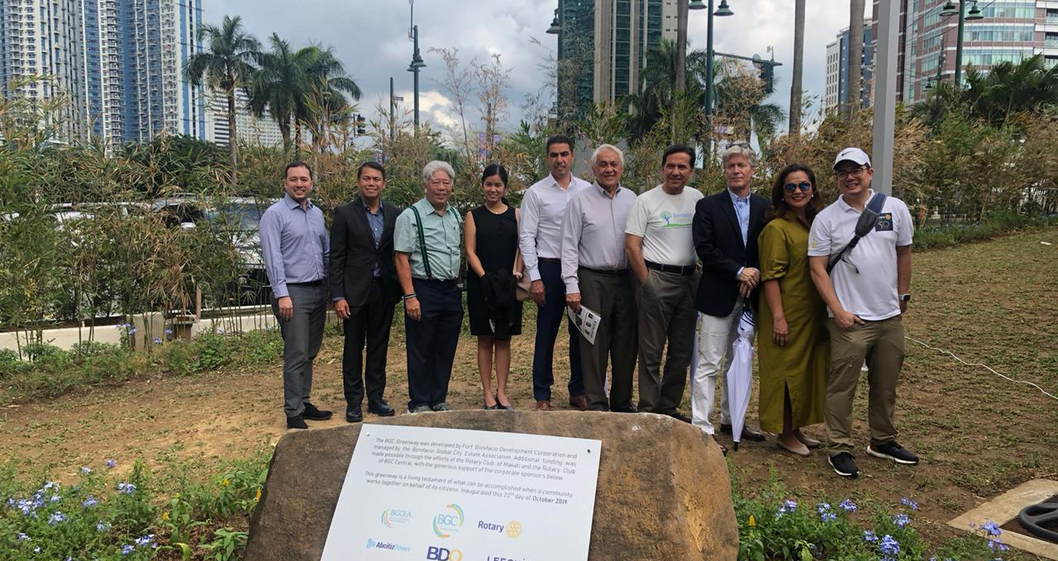
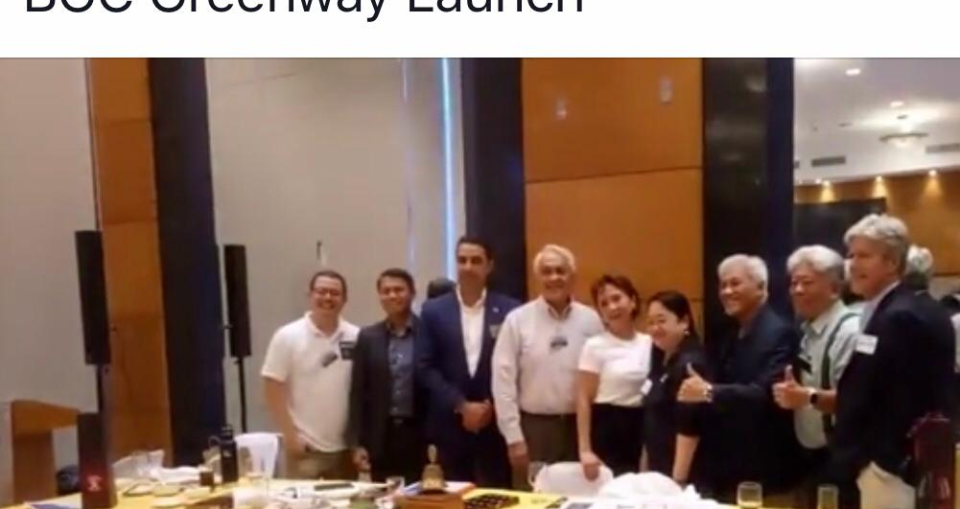
UPDATE ON BGC GREENWAY

Slide 10
RECENT PARTICIPATION IN ROTARY EVENTS
COMPLETED Events / Activities
Rotary Homes 10th Anniversary
  The City Club, 6pm, Monday October 28th
  Attendees: Gabriel
BGC Greenway 2nd Launch, Fairways Tower, Oct 22, 12pm-2pm
International Forum – Mon 4th Nov, 4:30-6:30pm
Governors Visit – Tuesday 5th November
PE Immersion – Garden Vegetable Patch Project – Saturday 16th November 2019
  One World School
  Approx 20 attendees
RC Makati Dasmarinas lecture series – Margot Torres CEO McDonalds Philippines – Wed 13th November – The City Club
Club Contributed to the Peace Monument to be erected in Paranaque – Php3,500
Board meeting Saturday 30th November
Rotary Club of Makati Dasmarinas (parent Club) 25th anniversary celebration, Marriott Hotel
RC BGC Central Christmas dinner and fellowship

Slide 11
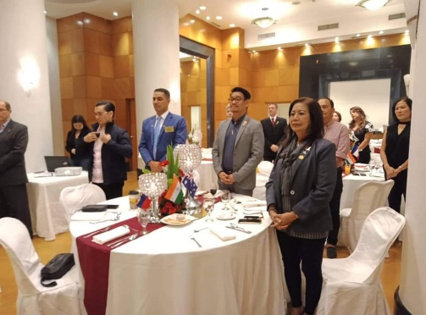
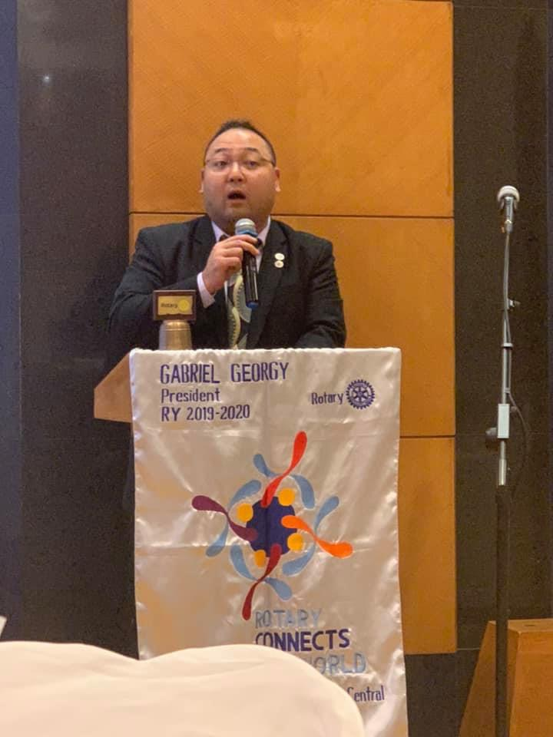
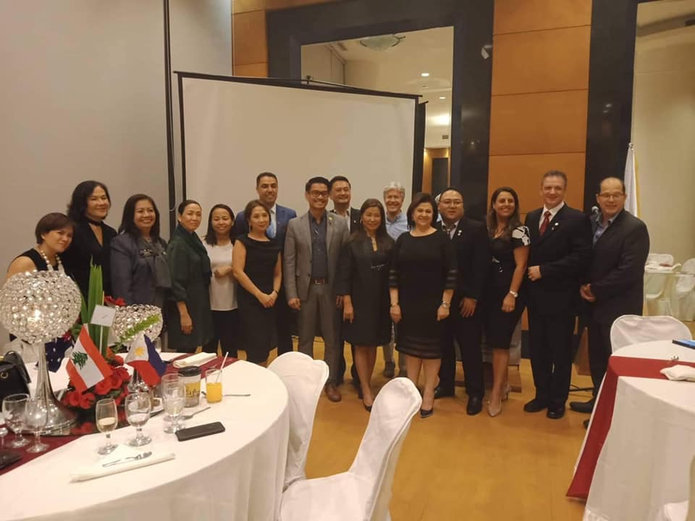
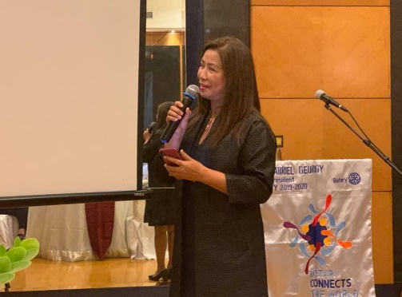
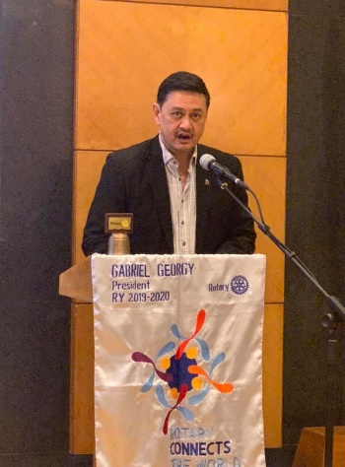
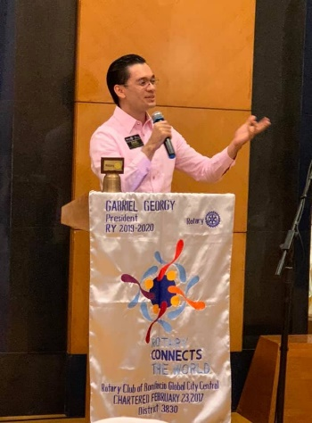
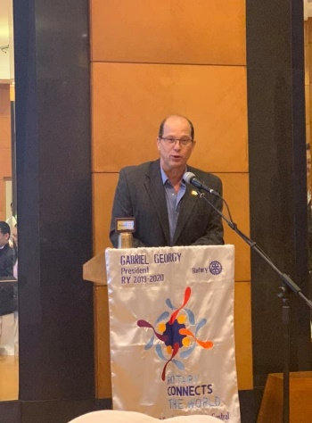
GOVERNORS VISIT – TUESDAY 5TH NOVEMBER

Slide 12
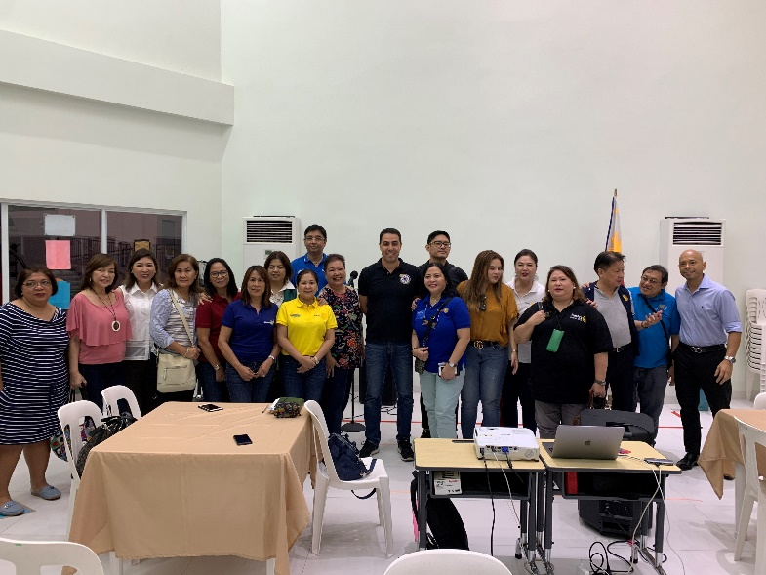
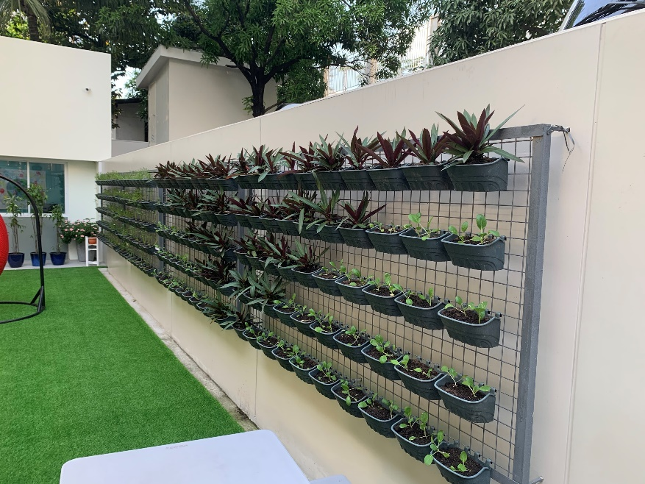
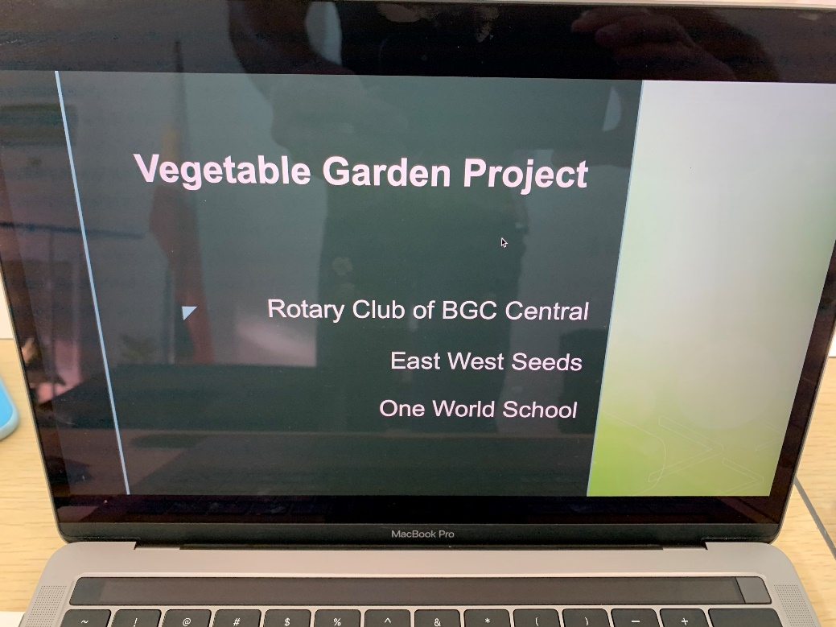
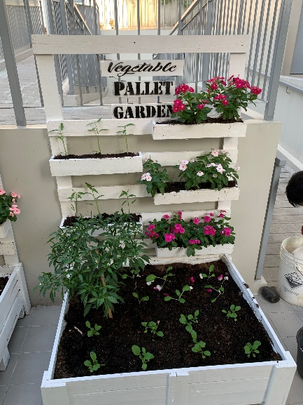
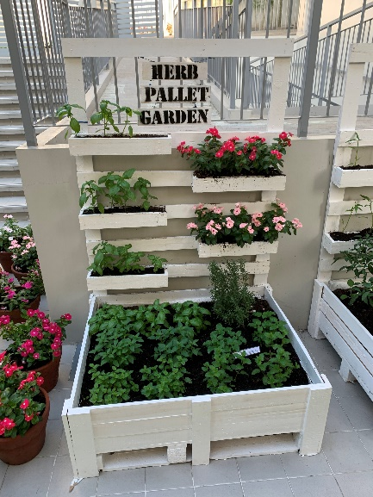
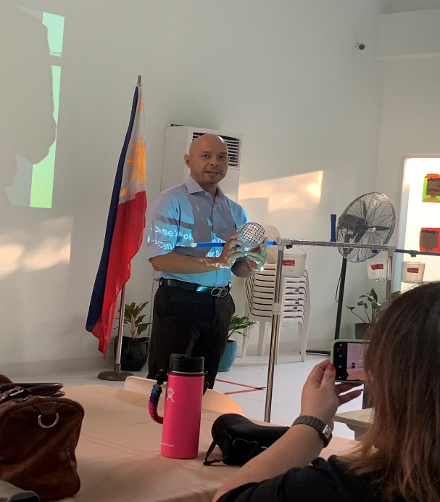
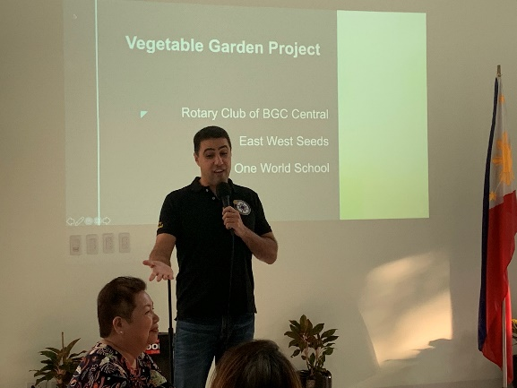
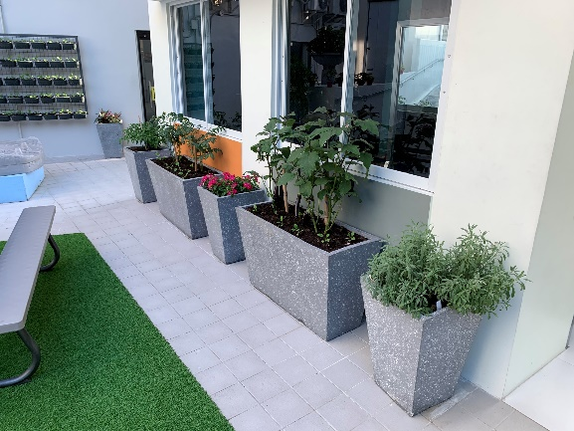
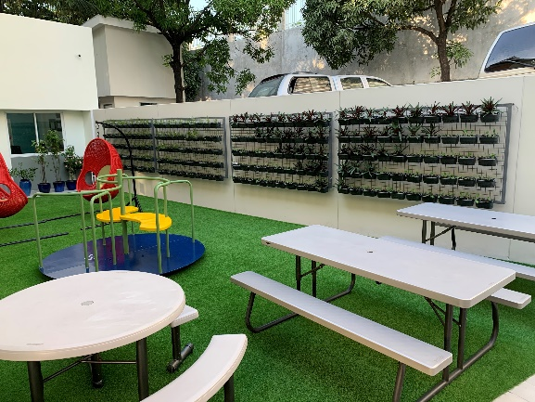
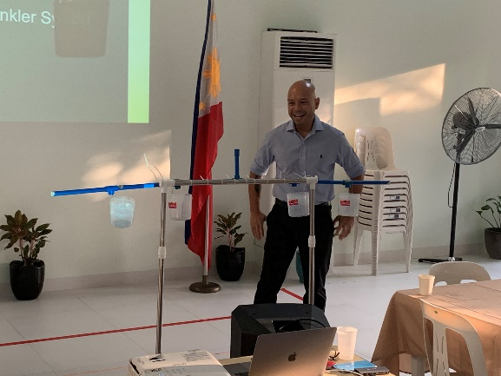
PE IMMERSION
Saturday 16th Nov at One World School

Slide 13
DISCUSSION WITH FOREIGN CLUB
Denver, CO, US
Hope Valley, UK

Slide 14
UPCOMING ROTARY EVENTS / ACTIVITIES
Visit to Compassionate Hope
  Thursday 30th January 10:30-13:30
  Antipolo
  Attendees: Simon Gemayel, Henk Hermans, Gabriel Georgy
  https://compassionatehope.org/sponsor/philippines-home-of-hope/
NEED TO PLAN THE NEXT FUNDRAISING EVENT
  Some discussion on a Jazz and Wine Night at Manila House
  Potential dates: ???
  Cost was to be capped at Php2000 per person

Slide 15
ELECTION OF CLUB OFFICERS FOR
FY 2020-2021
President - Rich
Secretary - Martyn
Treasurer - Amal
Foundation Chair - Gabe
Membership Chair - Cora
Service Projects Chair - OO
Public Image Chair - Donna
Club Administration – Janet

Slide 16
ELECTION OF CLUB OFFICERS FOR
FY 2021-2022
President – Janet
Secretary - Rich
Treasurer - Amal
Foundation Chair - Gabe
Membership Chair - Cora
Service Projects Chair - Kevin
Public Image Chair - OO
Club Administration - Liez

Slide 17

Thank You

