Slide 1

NUTRITION ‘ Feeding program’
FOR OUR COMMUNITIES barangay Fort BONIFACIO & WESTERN BICUTAN
Manila, Philippines

Slide 2
EXECUTIVE SUMMARY
Objectives
The objectives of the saving children Feeding Program include:
To Prevent Stunt growth of children thru educating mothers on healthy nutrition for their kids
Conduct nutritional workshops for mothers for their 1-3 y old children
Healthy Feeding being provided to malnourished children through education/ training and cooking and pre-prepared food
Show mothers how to prepare healthy hot meals
Provide nutritional supplement
Host Sponsor
Rotary Club of BGC Central - Manila, Philippines
International Sponsor (s)
Rotary Club of Nice Riviera Cote d’Azur
Corporations: TBD
Individuals: TBD
Total Budget
Php70 500 per batch of 30 kids, i.e. So 120 kids = Php282 000
for a minimum of 120 children (based on 4 batches of 30 kids each )
Notes:
Give a brief overview of the presentation. Describe the major focus of the presentation and why it is important.
Introduce each of the major topics.
To provide a road map for the audience, you can repeat this Overview slide throughout the presentation, highlighting the particular topic you will discuss next.

Slide 3
BACKGROUND
The Rotary BGC Central conducted a Barangay ( ‘ Village / community ) needs assessment and decided to fund a ‘feeding program’ at the Western Bicutan and Fort Bonifacio Barangays– Manila, Philippines
It will be our “ Happy Barangays ‘ project and will also involve the school with other activities as well as livelihood projects for the mothers in 2018
SCOPE
The Rotary BGC Central approached the Community in Taguig that requires supporting. Together with the local authority to provide a nationally recognised nutritional feeding program to address the needs of 120 underprivileged and malnourished children within the Barangay
Notes:
Give a brief overview of the presentation. Describe the major focus of the presentation and why it is important.
Introduce each of the major topics.
To provide a road map for the audience, you can repeat this Overview slide throughout the presentation, highlighting the particular topic you will discuss next.

Slide 4
FEED A CHILD for NUTRITION COSTING
Cost
  PHP 2350 per child / 6 months (approx. PHP 19.50 / day)
  Therefore 2350 x 30kids = Php70 500 per batch of 30 kids
  So for 120 kids = Php282 000
  (based on 4 batches of 30 kids each - for 120 Days or 6 months feeding program)
  Funding
  Phase 1 – funded 1 module at Php70,000
  Phase 2 - Rotary BGC Central
  RC Nice Riviera Cote d’Azur (France) – contribution of Php70,000
  RC Makati - contribution of Php100,000
Balance: need Php112,000 to fund 4 modules to make up the Php282,000 for total program.
  Timing
To start by APRIL 2018

Slide 5
HOW IS THE PROGRAM IMPLEMENTED
  Mechanics of Program
  Hot nutritious meal from the inexpensive and nutritious menu specifically designed by FNRI (Food and Nutrition Research Institute, a sub agency of Department of Science and Technology, also a National Agency) /DSWD nutritionists plus a cup of milk are given to children for 120 days.
  Mothers are organized in to groups and receive briefings on what the meals are, how they benefit their kids and why they should keep their kids in the feeding program.
  Roles and responsibilities are defined. Officers are elected and mothers are grouped into committees to learn how to cook.
    Mothers will cook at selected sites and discuss during committee meetings. Eating habits of children are developed like eating veggies, washing hands, etc.
  Full documentation is a requirement with baseline data, monitoring forms and all forms and procedure provided thru Barangay Social & health workers.
Notes:
Give a brief overview of the presentation. Describe the major focus of the presentation and why it is important.
Introduce each of the major topics.
To provide a road map for the audience, you can repeat this Overview slide throughout the presentation, highlighting the particular topic you will discuss next.

Slide 6
IMPACT
The Feeding Program is one of the most successful and longest running feeding program established in 2001. To date, close to 45,000 of the most malnourished children from various communities have benefited from it.
Children beneficiaries are weighed before and after the 6-month feeding period to monitor the progress of the program. The consistent results show that the children's nutritional status have improved significantly, i.e. from severely malnourished to normal or a 98% improvement in overall weight and nutrition status.
The milk requirement of the project is provided by Mead Johnson
Community based program, the children's health is addressed during the short brain development age that ends at 6 years.
Eating habits are established in the hope that the children do not revert back to being malnourished. In addition their parents are taught how to prepare low-cost but nutritionally-rich food on the family dinner table and how to best care for their families
Notes:
Give a brief overview of the presentation. Describe the major focus of the presentation and why it is important.
Introduce each of the major topics.
To provide a road map for the audience, you can repeat this Overview slide throughout the presentation, highlighting the particular topic you will discuss next.

Slide 7
HOW IS THE PROGRAM IMPLEMENTED
Partners and Coordination
DSWD (Department of Social Welfare and Development (a national Agency under the office of the President) and LGU (Local Government Unit or Taguig Local Government) are active partners in implementation
Kabisig conceptualized the program and is the overall in-charge of coordination.
DSWD provides technical supports and wide reach, mobilizing regional offices to help in the social preparation and organizations.
LGU fully supports the program thru its local Social Services Dept. and links it to the barangay level - Implementing support as the program is in their area and beneficiaries are their constituents.
Notes:
Give a brief overview of the presentation. Describe the major focus of the presentation and why it is important.
Introduce each of the major topics.
To provide a road map for the audience, you can repeat this Overview slide throughout the presentation, highlighting the particular topic you will discuss next.

Slide 8
HOW IS THE PROGRAM IMPLEMENTED
Partners continued……
Kabisig ng Kalahi (Kabisig): is a non-government organization (NGO) founded by Vickie Wieneke in 2001 in full partnership with the Department of Social Welfare and Development (DSWD) to help children of families in depressed and marginalized communities get access to proper nutrition. Their flagship entry point program is the Supplemental Feeding (SF) For Malnourished Children.
Local Government Unit (LGU): Public officials of the barangays and municipalities where the program is implemented also take part in the activities particularly in the organizing and training of the mother groups.
DSWD (Department of Social Welfare and Development
Mead Johnson Nutrition (MJN) Philippines Mead Johnson Nutrition has led the way in developing safe, high-quality, innovative products to help meet the nutritional needs of infants and children. With more than 70 products in over 50 countries, Mead Johnson products are trusted by millions of parents and healthcare professionals around the world. Proper nutrition is critical to providing a child with a best start in life.
Notes:
Give a brief overview of the presentation. Describe the major focus of the presentation and why it is important.
Introduce each of the major topics.
To provide a road map for the audience, you can repeat this Overview slide throughout the presentation, highlighting the particular topic you will discuss next.

Slide 9
RECIPIENT OF THE PROGRAM
For Malnourished Children &run in the local communities/ Barangays
The Supplemental Feeding Program is implemented over a six month period (120 feeding days) in the selected barangays.
Selected beneficiaries who are severely underweight and under the nutritional level are identified by the Barangay Health Center
The aim of the program is to deploy a holistic supplementary feeding program designed to effectively rehabilitate wasted and severely malnourished children 3 years old and up
Each Program will run for 120 feeding days, where low-cost but highly nutritious hot meals are prepared by the parents, given to the beneficiaries during lunch supplemented by a glass of milk.
Barangays
Kids from school of Gat Andres Bonifacio
Western Bicutan Barangay
Fort Bonifacio Barangay
Notes:
Give a brief overview of the presentation. Describe the major focus of the presentation and why it is important.
Introduce each of the major topics.
To provide a road map for the audience, you can repeat this Overview slide throughout the presentation, highlighting the particular topic you will discuss next.

Slide 10
FUN FACTS
The Rotary BGC Central has only 22 members, chartered on the 23rd Feb 2017 !
This will be our 2nd ‘Barangays’ community activity in 2018
First livelihood project
2nd event with twin sister club of Rotary Nice Riviera Cote d’Azur for 2018
Passionate bunch determined to raise funds through clubs, corporations and individuals as well as fundraising events
Notes:
Give a brief overview of the presentation. Describe the major focus of the presentation and why it is important.
Introduce each of the major topics.
To provide a road map for the audience, you can repeat this Overview slide throughout the presentation, highlighting the particular topic you will discuss next.

Slide 11
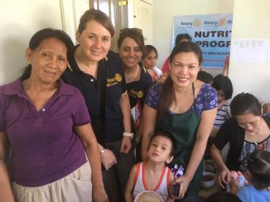

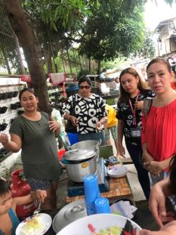
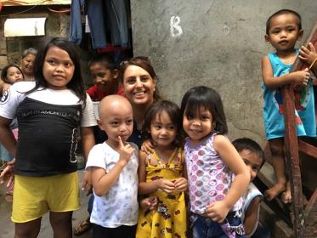
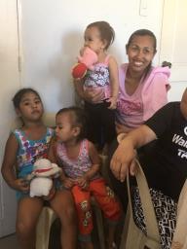
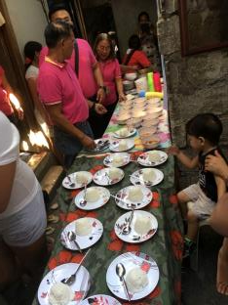
Photos from Phase 1 of the Nutrition feeding Program sponsored by RC BGC Central

Slide 12
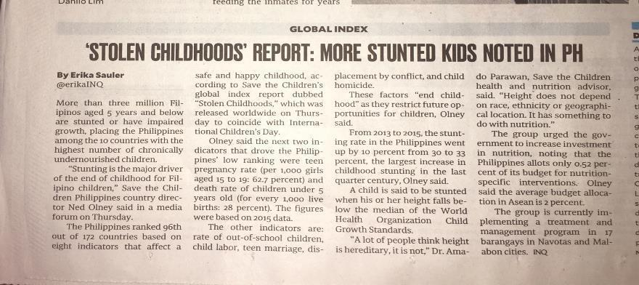
Notes:
Give a brief overview of the presentation. Describe the major focus of the presentation and why it is important.
Introduce each of the major topics.
To provide a road map for the audience, you can repeat this Overview slide throughout the presentation, highlighting the particular topic you will discuss next.

Slide 13
Thank you !
Our contacts
President - Simon Gemayel simon@rotarybgccentral.com
Chair Public Image – Isabelle reymond nilo isabelle@rotarybgccentral.com

